Slide 1
Chapter 12
The South Expands: Slavery and Society, 1800-1860

Slide 2
Disputed territory: W. of the Sabine River Ch. 12
Adams-Onis Treaty (1819)
Mexican Revolution
Tejanos
1821: Independence

Slide 3
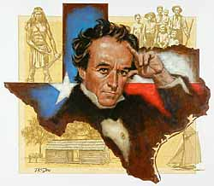
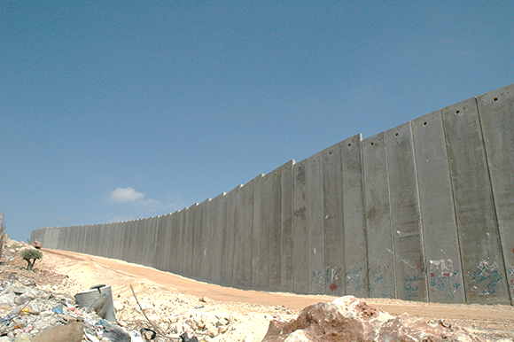
Moses and Stephen Austin
Erasmo Seguin
Empresarios
Unruly American immigrants > Mexico closes its border
Response?

Slide 4
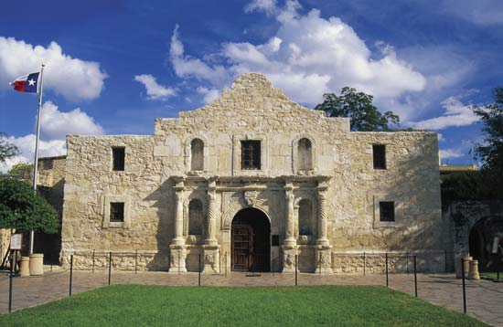
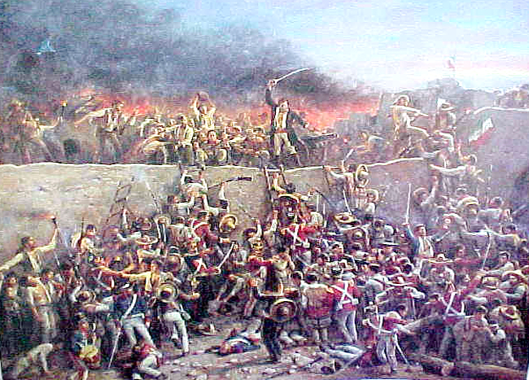
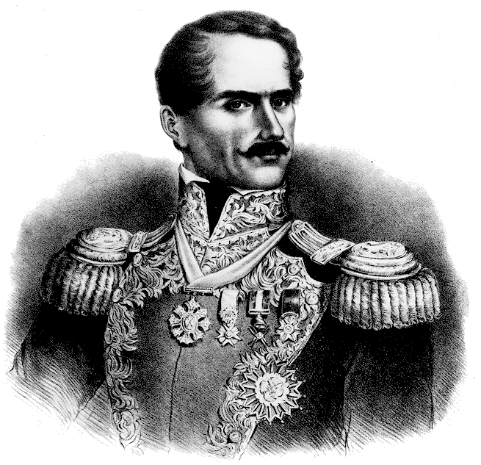
Desire for autonomy
Sam Houston
Texian vs. Mexican troops
The Alamo and Goliad
Santa Anna

Slide 5
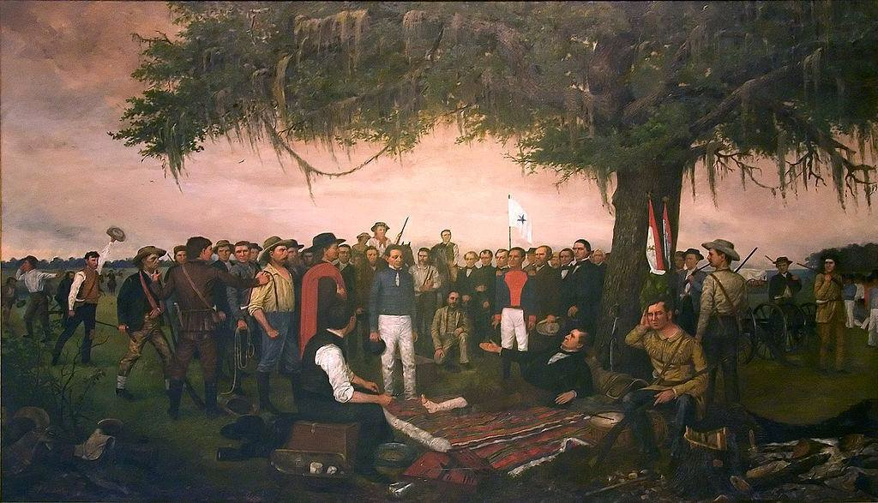
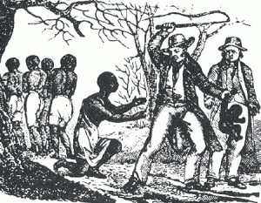
Final Mex. Defeat: Battle of San Jacinto
Treaty of Velasco
Houston:
Austin:
Hopes for what?
Why was the U.S. wary?

