Slide 1
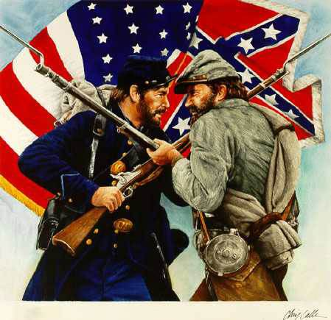
Chapter 14
The American Civil War
1861-1865
How did events on the battlefield shape the process, perception, and aims of the Civil War?

Slide 2
Mapping and Document Activity
On your map, create a key to denote which states joined the Confederacy and which remained in the Union.
Please indicate border slave states and Middle South states. (See p. 446.)
At points noted during lecture, you will label key campaigns.
Re. “HAPP and Answers,” we will look at three key documents from the war during lecture.
You will be responsible for answering analysis questions for all three.
You will choose whichever one appeals most to you and complete HAPP over that one document.
This is due Friday and is worth 16 points for accurate completion.

Slide 3
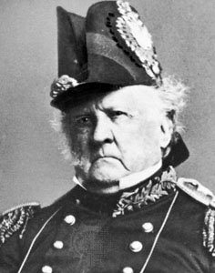
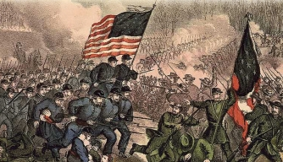
Fort Sumter (1861) followed by each side determining strategy Ch. 14
Ol’ Fuss and Feathers’ Anaconda Plan (LABEL)
Lincoln aimed for Richmond (Confederate capitol) (LABEL)
First Battle of Manassas (Bull Run): July 1861
https://www.youtube.com/watch?v=koLnFvPaya0
Rebel yell: https://www.youtube.com/watch?v=s6jSqt39vFM
Army of the Potomac (McClellan)
Army of the West (Grant)
Notes:
“The press ridiculed what they dubbed as Scott's "Anaconda Plan". Instead, many believed the capture of the Confederate capital at Richmond, only one hundred miles south of Washington, would quickly end the war…. Since General Scott was seventy-five years old and physically unable to lead this force, the administration searched for a more suitable field commander [which is why he didn’t command at Manassas].”
Union names: lakes and rivers. Confederate names: towns, RR junctions, and cities.
Mathew Brady was there to witness the battle.
Only civilian killed was Judith Henry (80-some years old, bedridden; house besieged by fire and her foot got shot off).

Slide 4
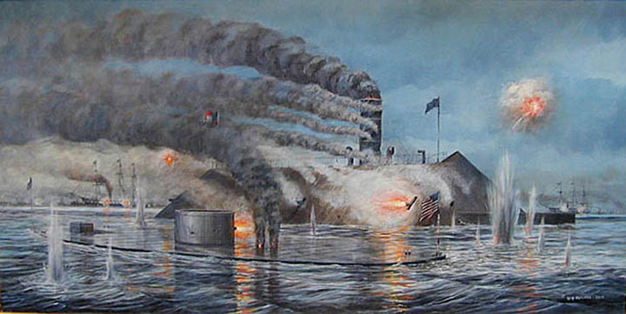
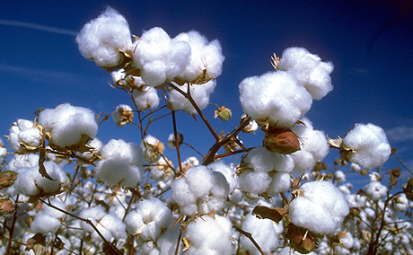
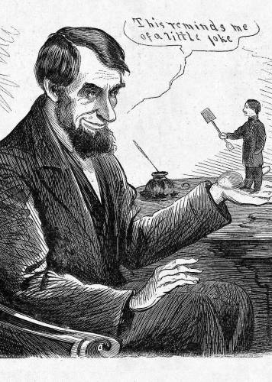
Confederate strategy: war of attrition
Hopes for Britain: why?
McClellan did not go hard enough
Union Navy more successful
Battle of the Ironclads (aka Battle of Hampton Roads) > a draw

Slide 5
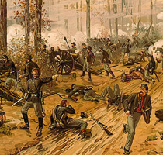
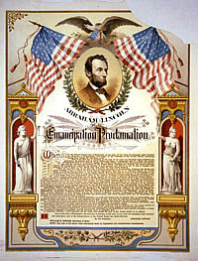
Tide turned in Union’s favor in 1862
Farragut and New Orleans: April 1862 (LABEL)
Western theater: Grant wins the costly Battle of Shiloh
McClellan’s painstakingly slow Peninsular Campaign of 1862
Stonewall Jackson and the Shenandoah Valley
Confederates victorious over Union forces (August 1862)
Union victory at Antietam (Sharpsburg) in Sept. 1862 (LABEL)
Lincoln FINALLY fired McClellan
Issuance of Emancipation Proclamation

Slide 6
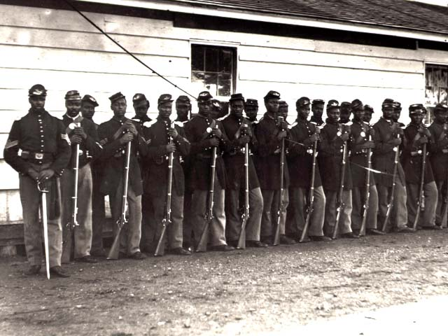
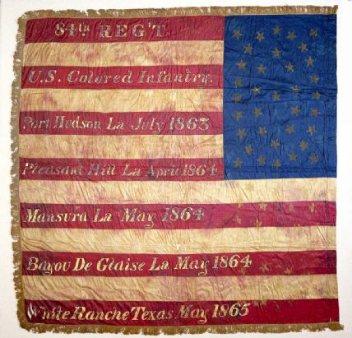
Lincoln’s views on slavery
“contraband of war”
Trying to keep border states in the union
Colonization efforts
Views of the war as “freedom war”
Interactions with slaves
Emancipation Proclamation: what did it do?
Peace Democrats
Black troops: see “Call for Black Troops”

Slide 7
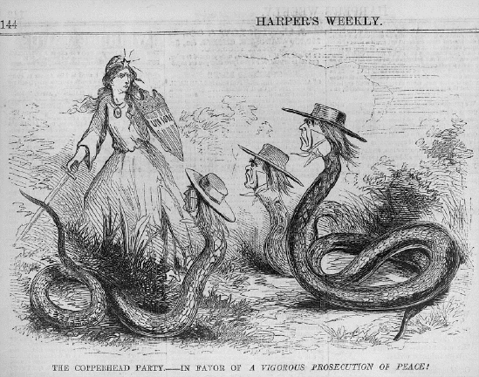
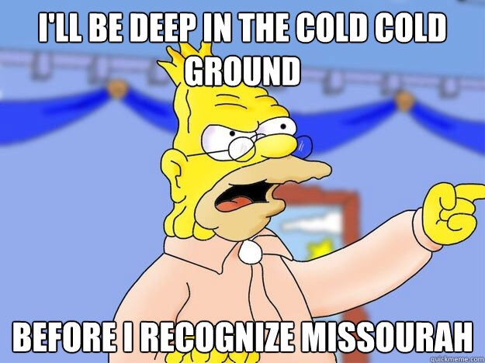
Increasing horrors of war and suffering: https://www.youtube.com/watch?v=B6du2B10K2w
Confederate problems
Life in the North (emphasis on emerging modern fiscal system)
Internal Revenue Service (yes, that IRS)
Greenbacks
Northern opposition to the war
Copperheads and Clement Vallindingham
Irish Catholics and draft riots
Notes:
Emerging modern fiscal system presages the gilded age

Slide 8
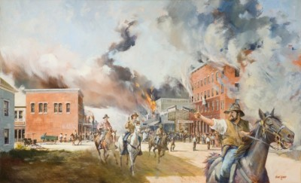
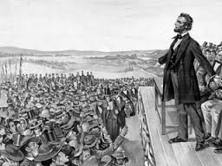
Fighting in the West
KS and MO
Native Americans
1863: Turning point
Chancellorsville (LABEL)
Gettysburg: see “Gettysburg Address” (LABEL)
Vicksburg (result, and who is General-in-Chief of Union now?) (LABEL)
1864: Battle of the Wilderness and Battle of Cold Harbor (at Petersburg)
Death blows to the Confederate cause: General Sherman (LABEL), Appomattox (LABEL)
https://www.youtube.com/watch?v=dsyz9dwjGdQ; see Grant’s Memoirs

Slide 9
