Slide 1
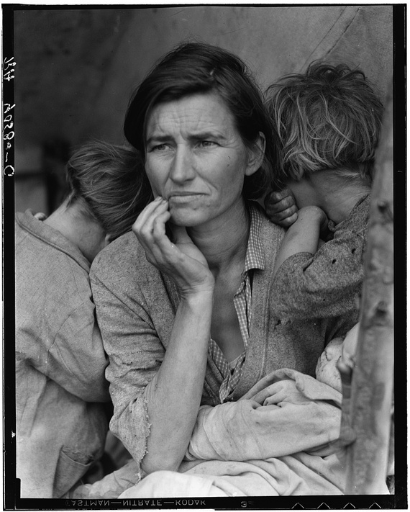
Chapter 23
Living in Hard Times

Slide 2
The Coming of the Great Depression https://www.youtube.com/watch?v=aPi9A07HqWg
Many different causes, including rampant speculation and buying on margin
Stock market collapsed on Black Tuesday, October 29, 1929
Half of Americans were living precipitously before collapse; now, situation got even worse
Exacerbated by Hoover’s lack of effective policies
Opposed to “government handouts”
Favored private aid and letting business heal itself
Finally, 1932: Congress created the Reconstruction Finance Corporation, to keep banks afloat
Emergency Relief and Construction Act lent money to states for public works projects
Tried and failed to aid German economy

Slide 3
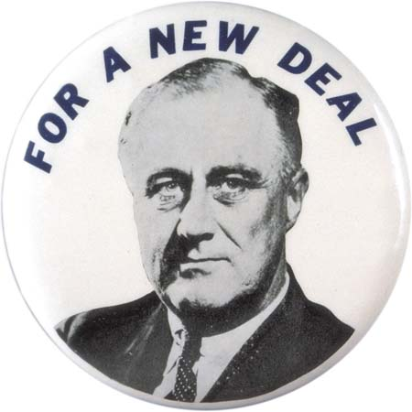
1930: Smoot-Hawley (or Hawley-Smoot) Tariff: highest tariff in history til that point
Resulted in decreased international trade
Further harm to American economy
Rise of the “Hoovervilles”
The Bonus Army debacle
FDR’s campaign for a “New Deal” attracted much attention; addressed deep concerns and fears that many Americans were feeling
Relief, recovery, and reform
Appealed to the “forgotten man”
FDR won in 1932 in a landslide election

Slide 4
FDR’s Actions
Hundred Days and First New Deal
Bank Holiday
Emergency Banking Act
Glass-Steagall Act: created FDIC, separated commercial and investment banks, and limited risky speculation
Economy Act
Amendment to Volstead Act to legalize beer
Civilian Conservation Corps (automatically sent portion of earnings to men’s families to help ease depression)

Slide 5
No more gold standard
Fed. Emergency Relief Act
Tennessee Valley Authority
National Industrial Recovery Act created the National Recovery Administration and the Public Works Administration
Brain trust
Lack of purchasing power as cause for depression
Engaging personality; “Fireside Chats” https://www.youtube.com/watch?v=jt9f-MZX-58
National Labor Relations Act (Wagner Act—technically 2nd ND) protected unions John L. Lewis and Congress of Industrial Organizations
the sit-down strike
Pushback from employers

Slide 6
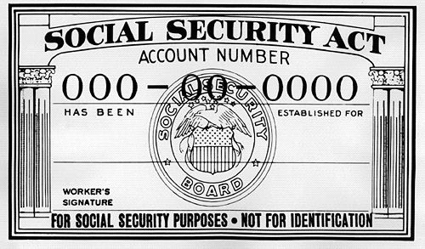
Strikes encourage opposition to FDR to grow
American Liberty League
National Assoc. of Manuf. Also opposed FDR’s programs
Far left: FDR didn’t do enough
Francis Townsend > Social Sec. Act
Upton Sinclair ran for CA Gov; shaped debate over key issues
Father Charles Coughlin
Huey Long (assassinated) https://www.youtube.com/watch?v=hphgHi6FD8k

Slide 7
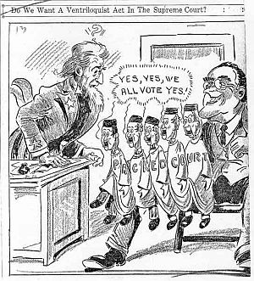
Second New Deal
Works Progress Administration
Farm Security Administration
Social Security Act of 1935 and Wagner Acts
1936: FDR beat Alf Landon and William Lemke
Court-packing scheme—increase justices to 15
Was the New Deal actually working?
Fair Labor Standards Act of 1938

Slide 8
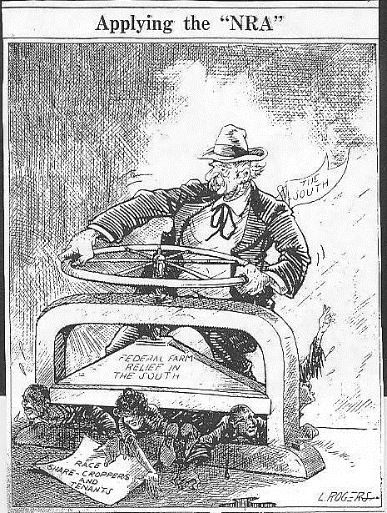
The Black and Mexican Experience
White Southern Democrats blocked strides toward equality
Indian New Deal (Indian Reorganization Act)
Celebration of Indian identity in small ways
Black Experience: New Deal was a mixed bag
State and local execution of law allowed discrimination
Segregation of some programs (CCC and TVA)
Disproportionately disadvantaged and not helped
Black Cabinet
Mary McLeod Bethune – Nat’l Youth Administration
Mexicans and Mexican-Americans also disadvantaged

Slide 9
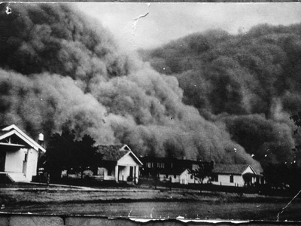
The Dust Bowl
OK, TX, CO, KS, AK, NM, NE
Overfarming/overgrazing (thanks to changes in technology and the farming industry/society) and long-term drought combined to destroy soil integrity and ability to farm
2/3 of population left (mostly white, mostly families with parents in 20s and 30s)
In the end, the New Deal was significant because it changed how Americans viewed the purpose and place of government, and
how the Democratic Party shifted its base to include blacks and
union workers.

Slide 10
WWII on the Horizon
WWII truly ended Great Depression
Seeds: Treaty of Versailles and Great Depression
Nazi Party feeds on fears and unhappiness
Hitler quickly rose and consolidated his power
Italy and Mussolini
Japanese expansion; “Asia for Asians”—what did that mean?
Rape of Nanking
The Stimson Doctrine and American nonintervention
European nonintervention in Asia

Slide 11
Appeasement and accommodation failed
Re-thinking WWI in America: Nye Committee
WWI was pushed by businessmen and bankers
Had been avoidable
Neutrality Acts aimed to keep America out of the conflict
Travel at own risk; arms embargoes
How to help the Allies without actually helping Allies
Abraham Lincoln Brigade in Spanish Civil War
Sinking of the U.S.S. Panay by Japanese
Flow of U.S. materials to Japanese not hindered by Neutrality Acts—why?

Slide 12
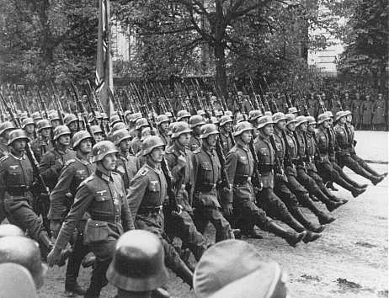
Lack of American (and British) action on behalf of Jews under Hitler’s reign
German ship St. Louis
Little increase in immigration
Opponents: America First Committee (incl. Charles Lindbergh, e.e. cummings, and others)
By 1939: Most Americans did support Britain and France, but aren’t willing to commit troops

