Slide 1
Quick Review:
How did the term “liberal” change during the New Deal?
What new roles did the government assume during the 1930s? How did these roles shape the economy and society?
How would you respond to the charge that Hoover was a do-nothing president? What evidence would you cite to support your response?
How did different groups take issue with the New Deal? How did FDR respond to criticism and outside pressure?
How did the lives of women, workers, and racial and ethnic minorities change during the Great Depression? What role did the New Deal play in helping these groups of Americans?

Slide 2
Chapter 24
LIVING IN A WORLD AT WAR

Slide 3
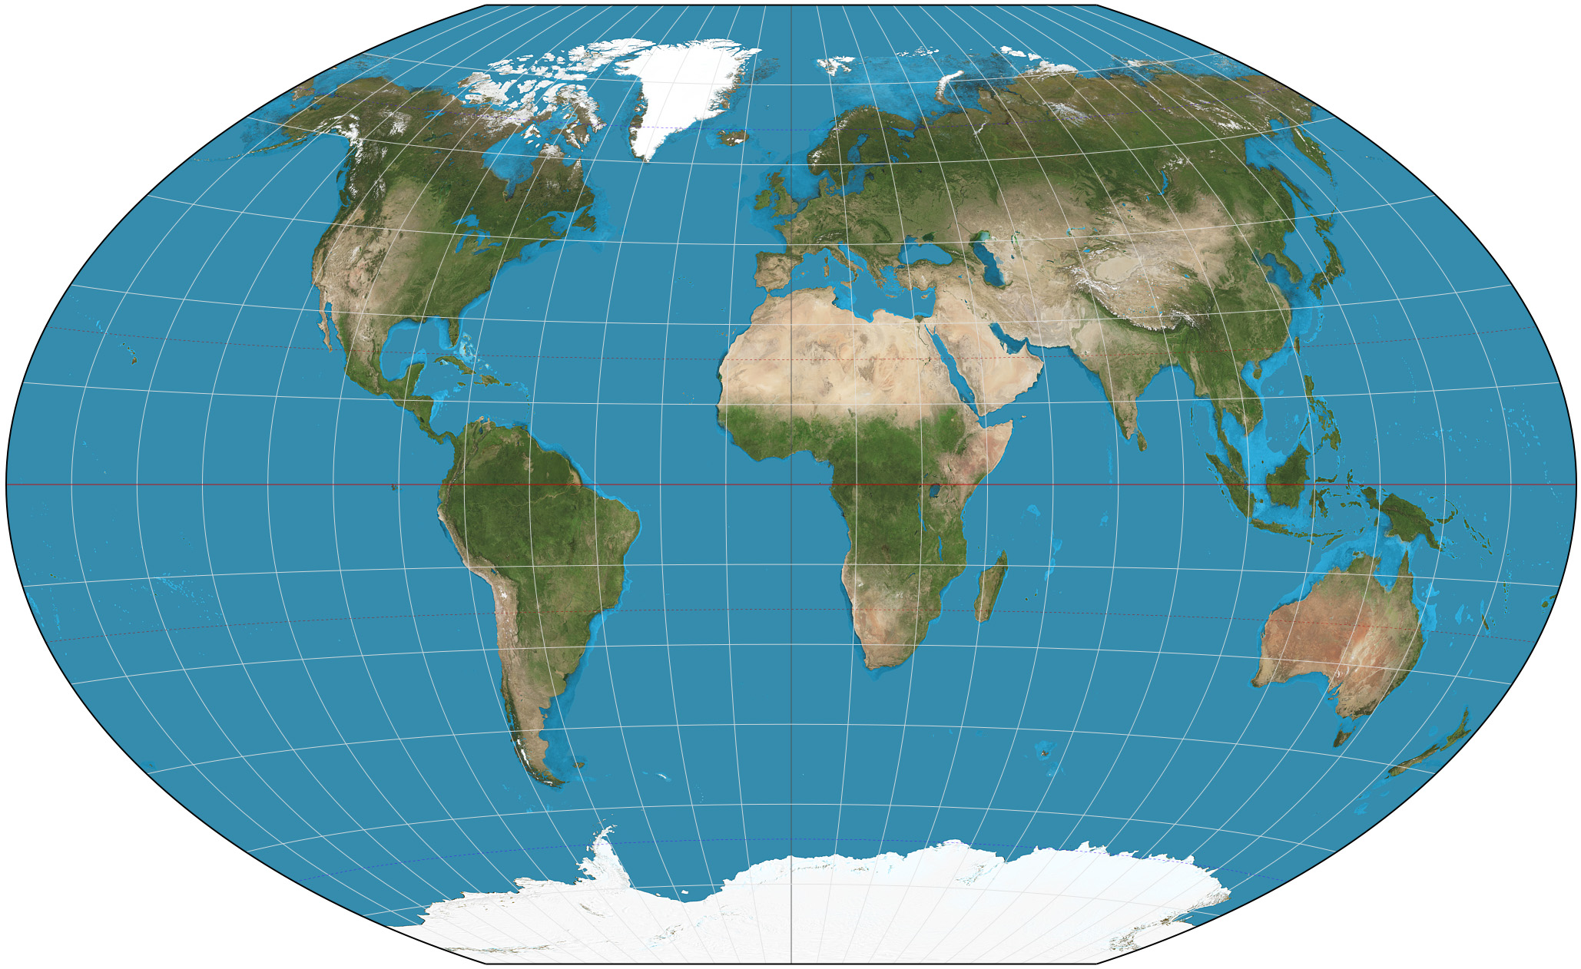
Fortress Euro.:
USSR:
USA:
N. Africa:
USA:
Pac. Theater:
USA:

Slide 4
With USA partners: Why was WWII significant to America and the world? (Write an answer in this box.)

Slide 5
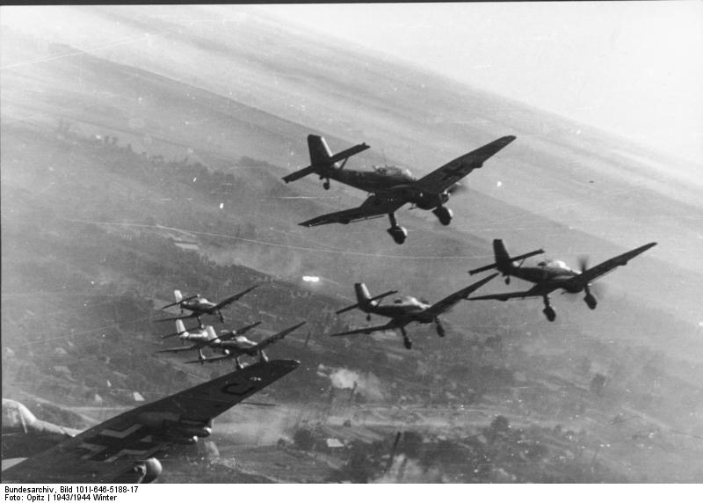
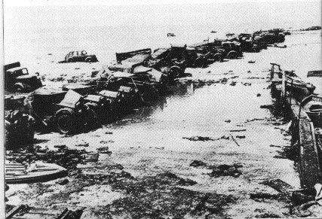
First objective, Preparedness and Isolation, 1939-1941: Explain support for and opposition to the growing U.S. support for Britain and growing tensions with Japan.
Growing tensions and concerns
G and J aggression precipitates Neutrality Acts
Watching the “phony war”
Europe falters
April 1940: Denmark and Norway fell
Blitzkrieg against Holland and Belgium
Invasion of France
“Miracle at Dunkirk” https://www.youtube.com/watch?v=F-eMt3SrfFU
FDR seeking ways to aid Britain
Reluctance at home: Lindbergh, America First Committee
Destroyers-for-bases

Slide 6
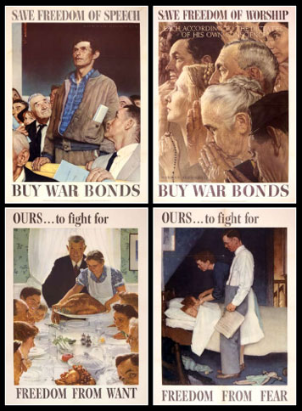
Election of 1940: FDR vs. Wendell Willkie
Differences and similarities?
Meanwhile, Britain fighting alone
FDR’s responses
“Arsenal of Democracy” https://www.youtube.com/watch?v=8oI-xc7XbWA
Lend-Lease Agreement
Four Freedoms:
1.
2.
3.
4.
Illustrated by whom?

Slide 7
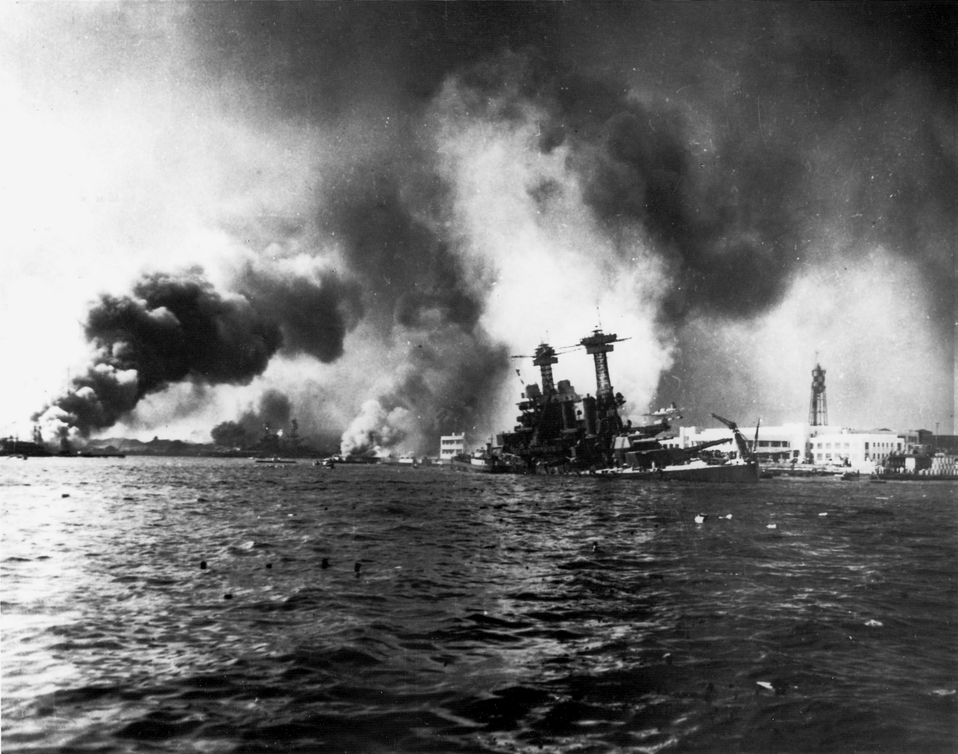
1941: Pivotal Year
Isolationism still strong, but…
Large draft army
Unemployment decreased
Rising scope and power of navy
Atlantic Charter
Meanwhile, U-boats continued their hunts
Building to December 7, 1941
USA provided minimal support for Chinese Nationalists; still sent metal and oil to Japan
Expanding Japanese imperialism and alliance with Axis Powers
Pearl Harbor, “the day that will live in infamy”
America unifies and moves

Slide 8
With Fortress Europe partner: How do you assess FDR’s actions so far?

Slide 9
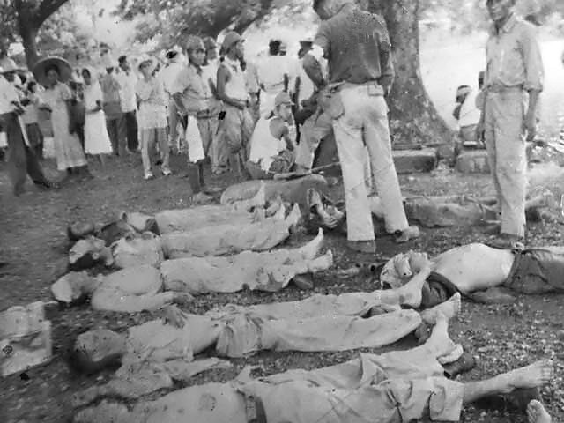
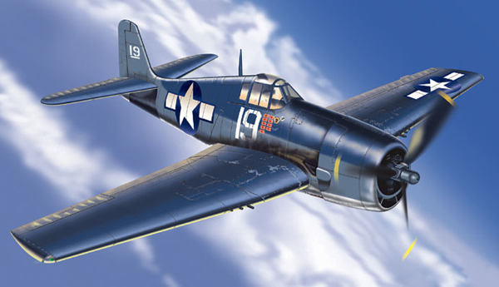
Second objective, Mass Mobilization in a Society at War: Analyze the war’s early timeline in the Pacific as well as its impact on widely diverse groups of Americans who fought, supported the war effort at home, or otherwise lived through the years of the war.
Early Pacific losses
ABC-1 Agreement
MacArthur (Pacific Theater General) temporarily defeated
Bataan Death March https://www.youtube.com/watch?v=u0HD6eEcViU
1942: Japan controlled W. Pacific
Tide of war in Pacific shifted with what battles?
The Hellcat based on (and better than) the Japanese Zeros
Guadalcanal

Slide 10
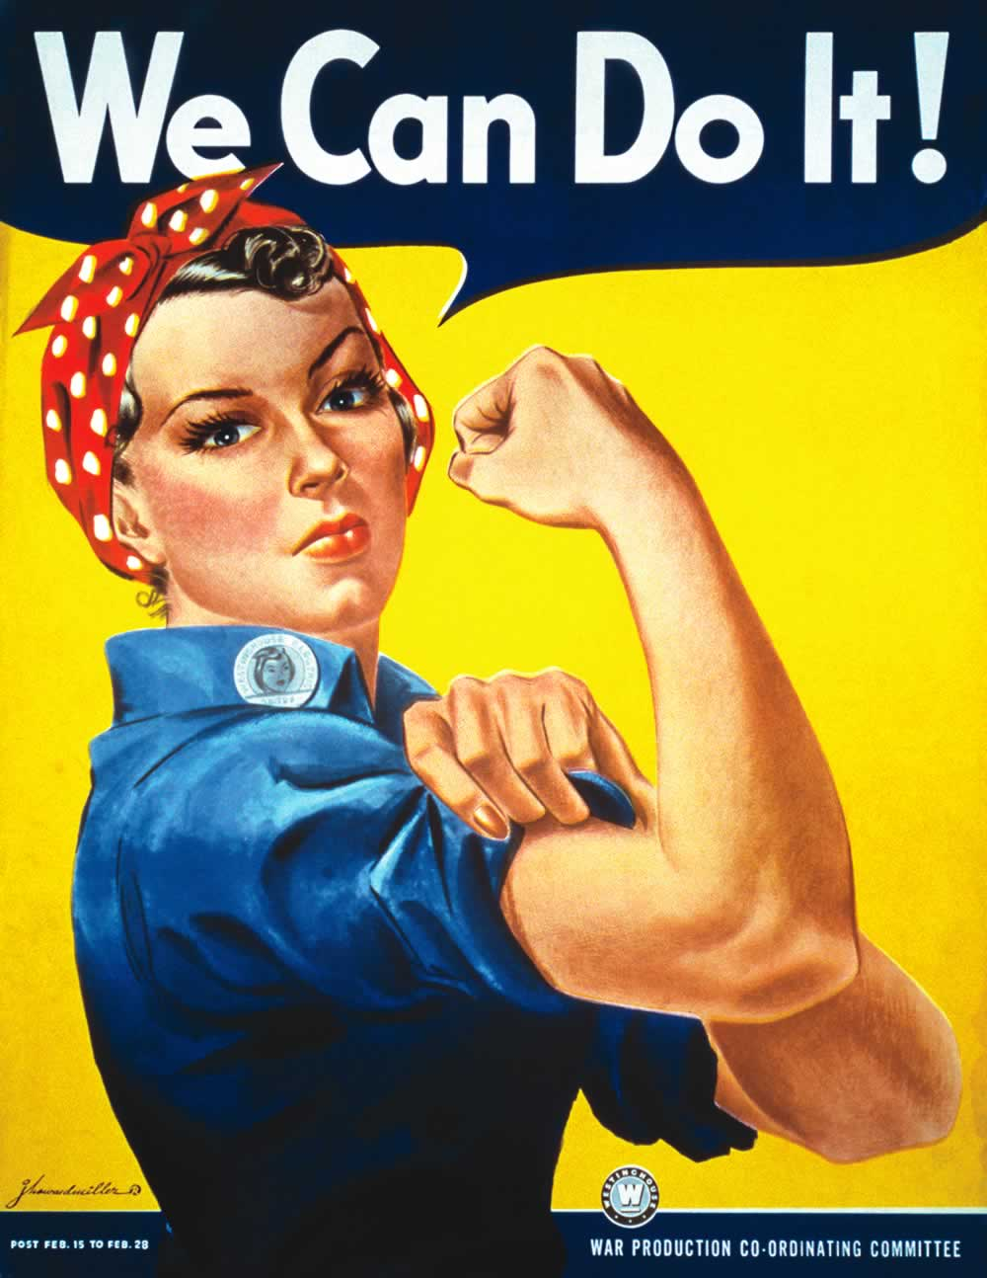
Selective Service and regional differences:
Tydings Amendment exempted who?
Conscientious objectors
Women: WACs, WASPs, etc.
New jobs and industries
Rosie the Riveter
Black Americans
A. Philip Randolph
E.O. 8802:
Fair Employment Practices Commission
Double V Campaign

Slide 11
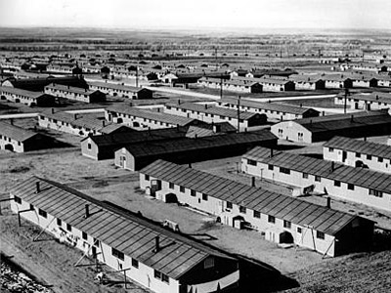
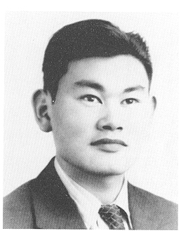
Latinos
Zoot Suit Riots; bracero programs
https://www.youtube.com/watch?v=1IqH3uliwJY
Japanese-Americans
Tensions grew after Pearl Harbor
Role of economic competition
EO 9066:
Korematsu v. United States
Who won?
Who really won?

Slide 12
With USSR partner: Based on your own identity and family history, how may your family have been impacted by World War II, in political, social, economic, or military terms?

Slide 13
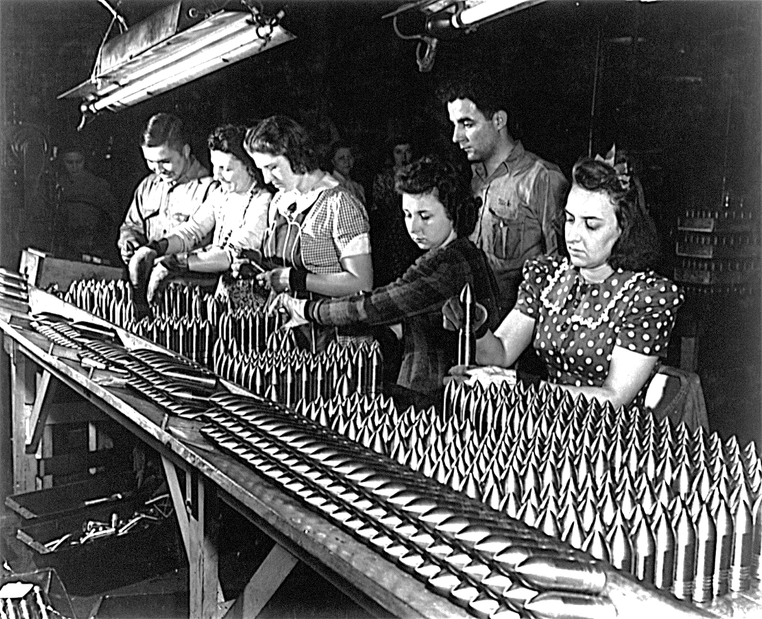
Third objective, Industrial Strength and Industrial Prosperity: Analyze U.S. industrial strength and productivity and its impact on the outcome of the war and on American society.
Why did the U.S. excel at wartime production?
1.
2.
3.
4.
War Production Board
Liberty Ships

Slide 14
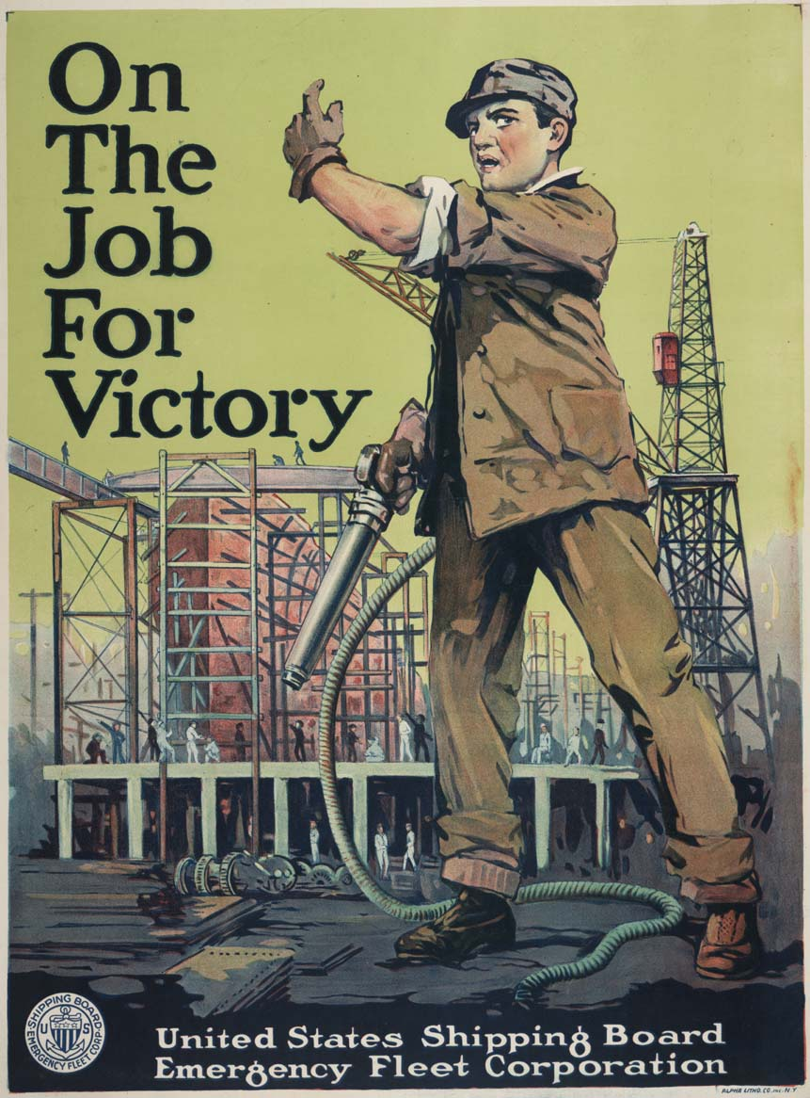
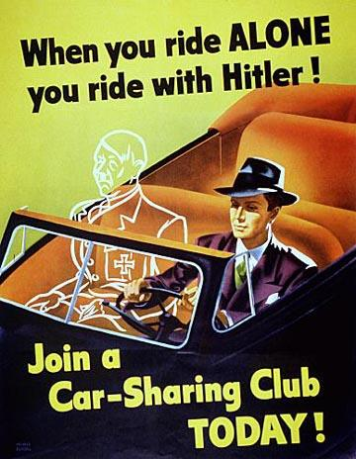
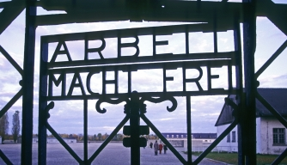
Office of Price Administration
National War Labor Board
Little Steel Agreement
“no strike pledge”
Prosperity despite rationing
Why did America not pay more attention to the Holocaust?
1.
2.
3.
Paying for the war: 1942 Revenue Act alongside borrowing

Slide 15
With North Africa partner: How would you characterize average Americans’ contributions to the war effort? Provide several examples to support your claim.

Slide 16
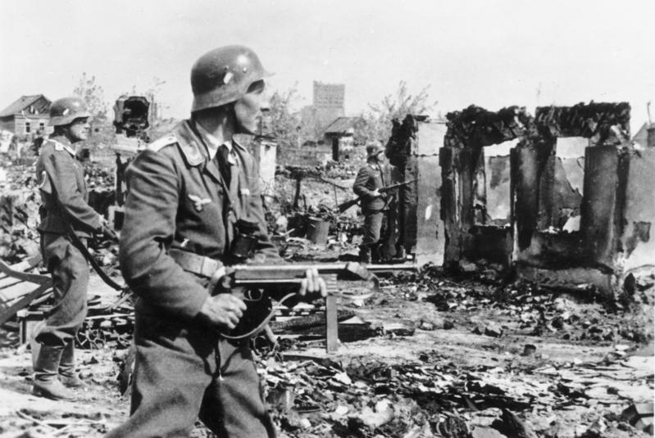
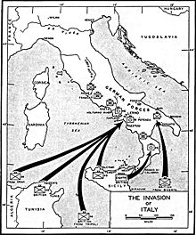
Fourth objective, Winning a World War—North Africa, Europe, Asia, the Pacific, 1943-1945: Explain the course of the war leading to victory in Europe and then the Pacific.
Russia pressured Allies to fight harder in Europe
Casablanca Conference in January 1943--three agreements:
1.
2.
3.
Also, only accepting unconditional surrender would suffice
Siege of Stalingrad
“Fortress Europe”
Attack through Italy in June 1944

Slide 17
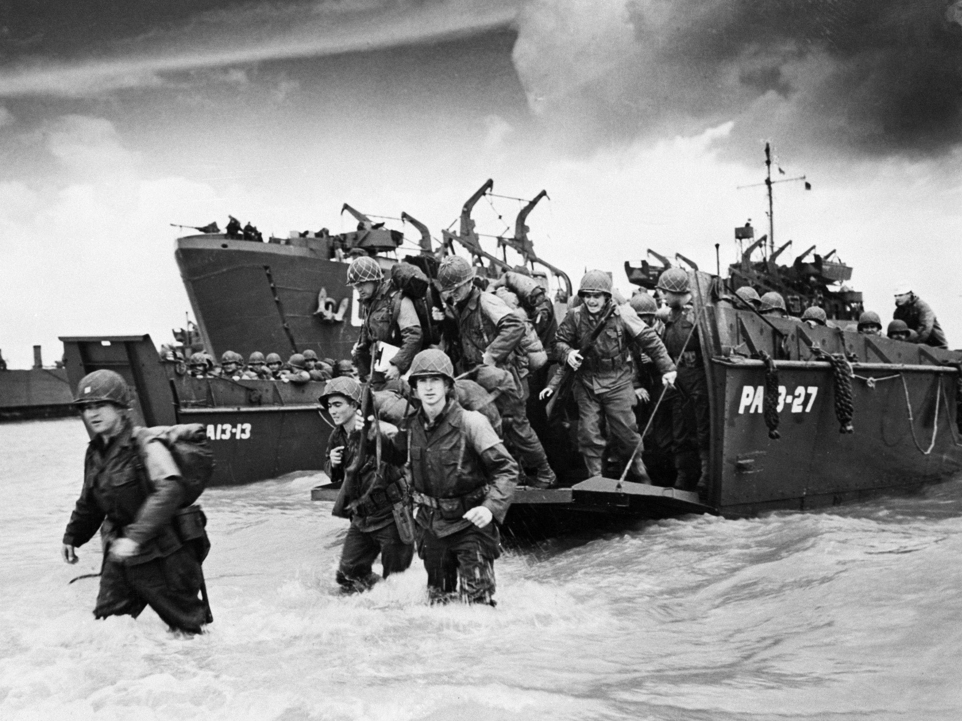
Relentless air assault on Germany
“Terror bombing”
Staggering losses
Tehran Conference in Nov. 1943: Stalin, Churchill, and FDR
Operation Overlord and General Eisenhower (European Theater): D-Day https://www.youtube.com/watch?v=ycClInnEO1U&feature=youtu.be
Final German defeat: Battle of the Bulge in December 1944
Full horrors of Holocaust slowly realized
April 30, Hitler’s suicide; May, ceasefire effectively ended war

Slide 18
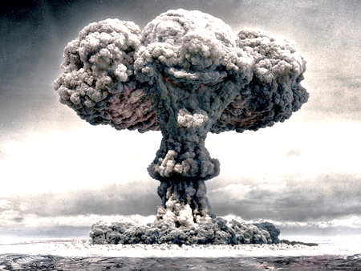
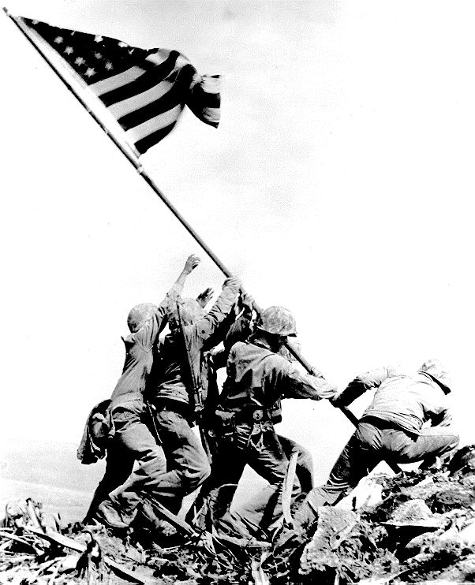
FDR died in April 1945, before the Germans surrendered
Had beaten Dewey in 1944
Truman assumed Presidency (beat Henry Wallace for the ticket)
Attention back to the Pacific Theater… https://www.youtube.com/watch?v=1qe2Y9XN-2o
Navajo code talkers: https://www.youtube.com/watch?v=omMLFKHKyRQ BUT YOUR BOOK LEAVES SO MUCH OUT.
Most brutal and intense fighting
Island hopping
Battle of Leyte Gulf
Iwo Jima in Feb. and March of 1945 https://www.youtube.com/watch?v=8rfsRNeiing
Manhattan Project began in 1942
Hiroshima and Nagasaki: August 1945
John Hersey
Japan surrendered on September 2, officially ending the war

Slide 19
You will work with your Pacific Theater partner on a documents-based lesson over the Atomic Bomb on block day this week.

Slide 20
Return to your initial USA group and review your answer to the question. What can you add to your answer to reflect greater commitment to historical accuracy after lecture?
Please use a different writing instrument to make your revisions/additions obvious.

