Slide 1
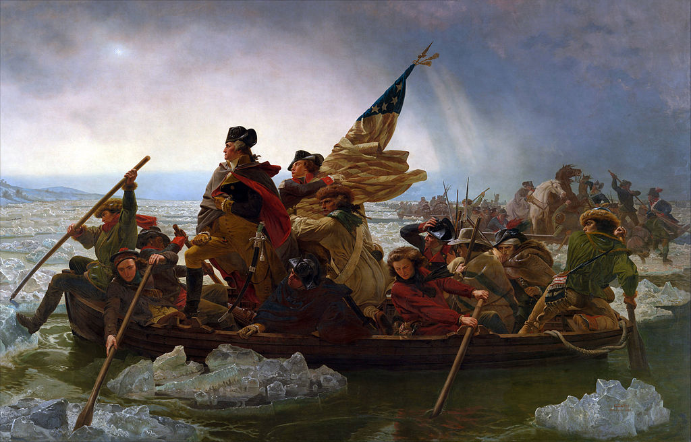
Chapter Six
The Revolution and its Aftermath

Slide 2
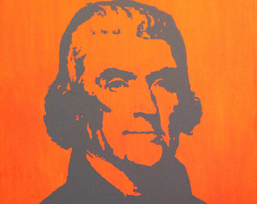
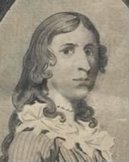
Jefferson and the Declaration of Independence
Articles of Confederation (weak)
American vs. British troops
Women and Deborah Sampson
Washington’s leadership

Slide 3
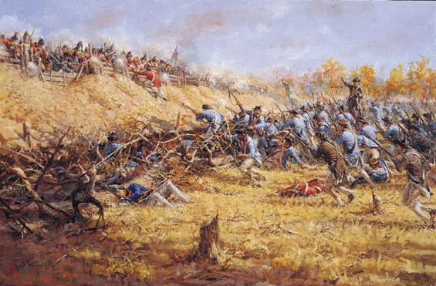
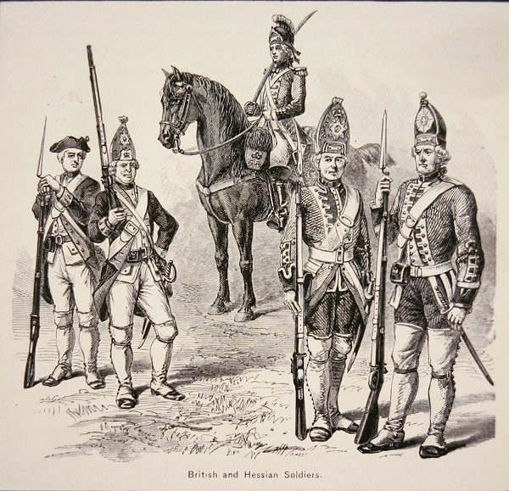
1776: Howe became British commander
Hessians
Christmas 1776: Crossing of the Delaware
1777: Burgoyne vs. Gates at Saratoga
Turning point: how so?

Slide 4
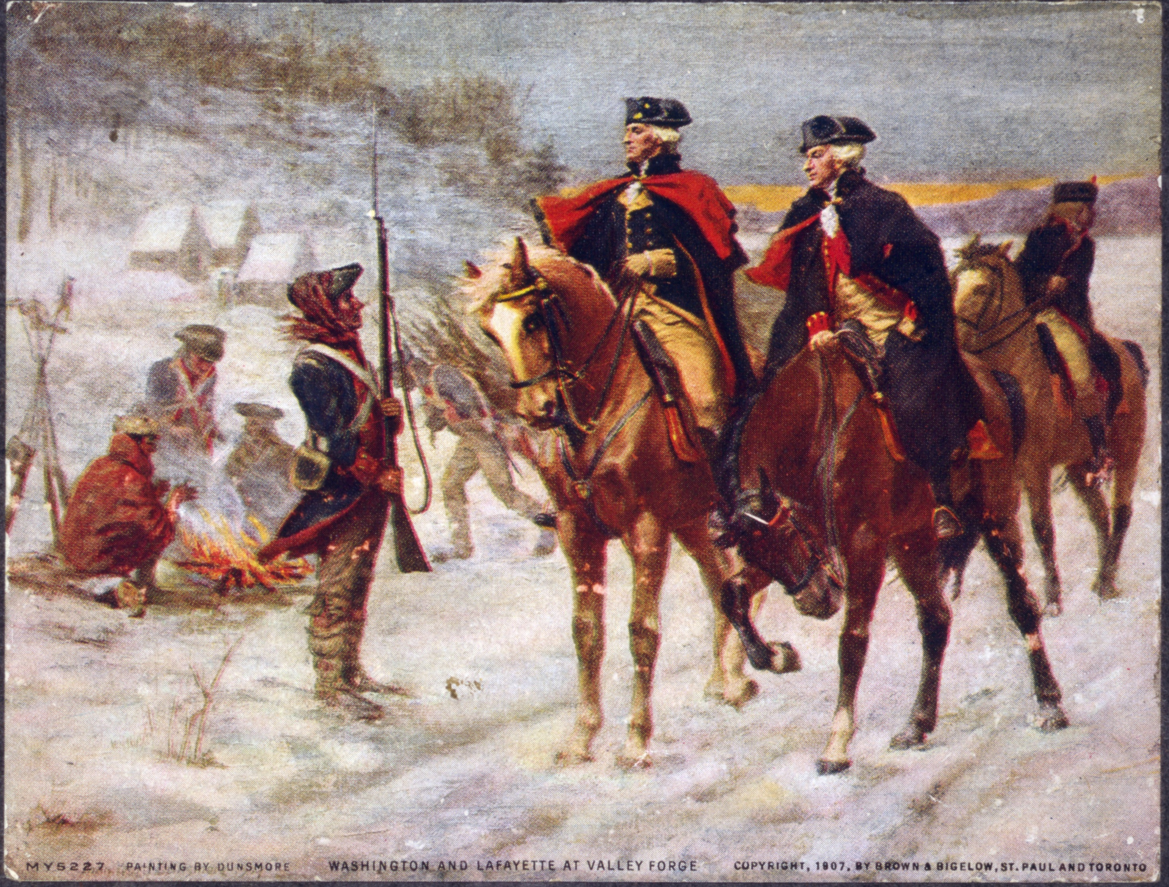
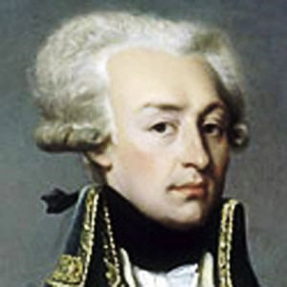
Brits in Philly: 1777
Winter at Valley Forge
Baron von Steuben and Marquis de Lafayette
1778: Gen. Clinton replaced Howe
Brits adopt new strategy

Slide 5
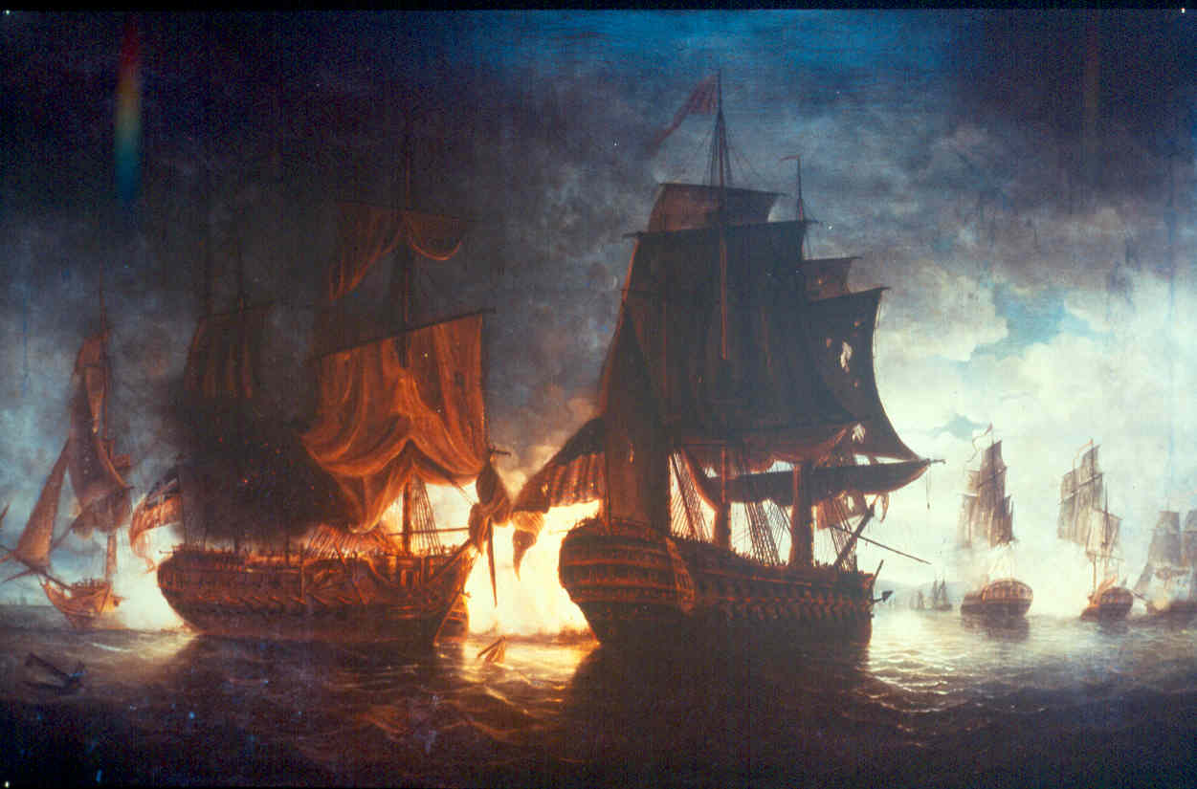
France and Spain
Franco-American Alliance
John Paul Jones
Bonhomme Richard vs. Serapis
Iroquois split
Thayendanegea (Joseph Brant)
Loyalists

Slide 6
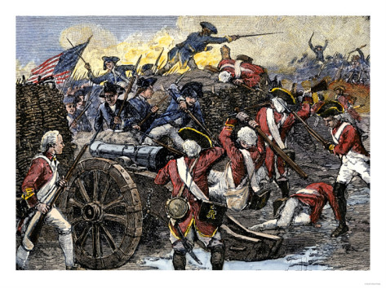
South
Savannah and Charleston
Daniel Morgan and Battle of Cowpens
Lord Cornwallis and Yorktown
Treaty of Paris (1783)

Slide 7
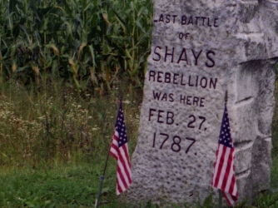
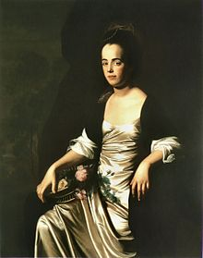
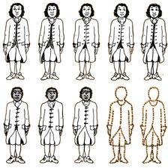
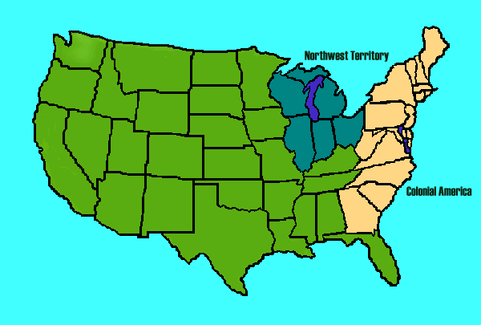
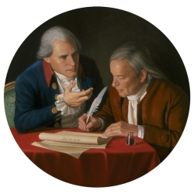
Creating Our Government
Terms:
Northwest Ordinance(s)
Shays’s Rebellion
Connecticut Compromise
Slavery in the Constitution…(?)
Federalists vs. Anti-Federalists
Judith Sargent Murray
You’ll have ~10 minutes to prepare a 60-second
presentation that explains this topic’s significance
to this period in US history. I will use a timer!

Slide 8
Northwest Ordinance: One of the few successes of the Articles of Confed.
1784: Established idea of statehood for territories in the NW Ord. area
1785: Established surveying procedure, split land into large rectangular parcels, set price of acreage at $1 minimum
1787: Created boundaries for Ohio, Indiana, Illinois, Michigan, and Wisconsin; prohibited slavery; established local support for schools; established procedure for creating constitutions and applying for statehood as populations grew
Shays’s Rebellion: After the war, most states established policies that protected debtors from predatory creditors; Massachusetts did not, by virtue of its elite-run legislature. It also increased taxes dramatically on farmers, who faced ruthless creditors and seizure of assets when they could not afford to pay both their taxes and debts. Protests of these high taxes and seizure of assets prompted this rebellion, members of which saw themselves as the inheritors of the Patriot cause. This rebellion failed; it represented the need for a stronger national government that would stop states from instituting harsh, unwise measures and be able to direct policy.
Connecticut/Sherman’s/Great Compromise (of 1787): Struck a balance between the NJ and VA plans. Provided for a bicameral legislature. One of many examples of compromise at the Constitutional Convention.
Slavery in the Constitution…(?) Referred to as “all other persons,” slaves were not given rights by the Constitution and were counted as 3/5ths of a citizen for purposes of taxation and representation. “Immigration” could not be regulated by the government until 1808 (at which point the international slave trade was abolished in the US), and there is an early version of a fugitive slave law put into place. Ultimately, slaves’ status as property and the South’s reliance on slavery worked against those trying to write slavery out of the new nation.

Slide 9
Federalists vs. Anti-Federalists: “Federalists” supported a stronger national government, which they argued for through pamphlets, books, speaking tours, and essays, such as the infamous Federalist Papers (which asserted that a large state with many factions within it could more effectively promote liberty, by preventing any one faction from becoming too powerful; also argued that the three branches proposed in the Constitution could “check and balance” each other; among other arguments). Anti-Federalists argued that the proposed Constitution served elite interests, took too much power away from state and local governments, and did not effectively guarantee individual rights. These distinctions gave rise to the first political parties during Adams’s administration.
Judith Sargent Murray: An early feminist writer, Murray argued that women were not naturally intellectually inferior to men; women needed better educational and economic opportunities.

