Slide 2
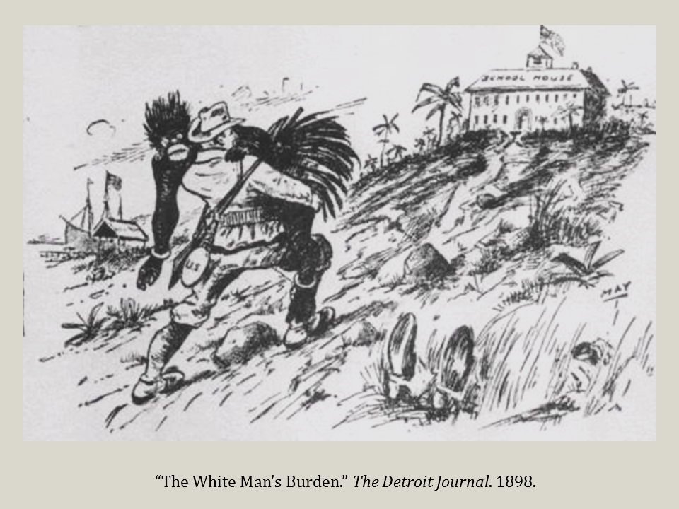

Slide 3
Would you rather have feet for hands or hands for feet?

Slide 4
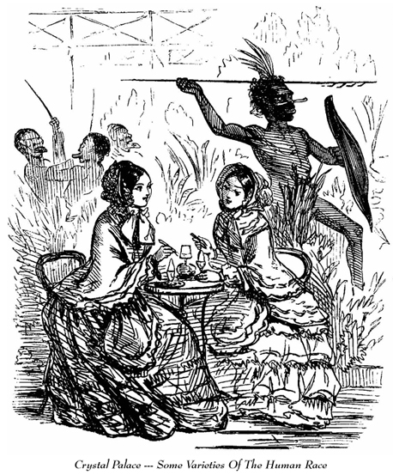
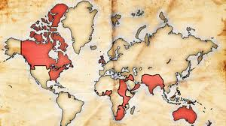
Industry Creates New Age Of Imperialism
19th century Europeans began to view others nations as sources of raw materials
Influence of industrial capitalism principles
Manufactured goods traded for resources
Imperialism: the extension of a nation’s economic/political power over other lands
Motivations behind European Imperialism
Capitalists driven to control others by profit
Greater control over raw materials & markets
European rivals used empires as leverage
Colonies were viewed as sources of pride & symbols of national strength & dominance
Social Darwinism and Racist Attitudes
Social Darwinists believed that “survival of the fittest” culture was to the benefit of mankind
Racist attitudes (belief in the superiority of certain races) were common within Europe
Humanitarian approach to Imperialism
“White Man’s Burden” to civilize & Christianize the “savage” people of the world
Great Britain built a global empire (below) based on motivations for profit and often racist attitudes (above).

Slide 5
Would you rather always have to say what you think
or never be able to speak again?

Slide 6
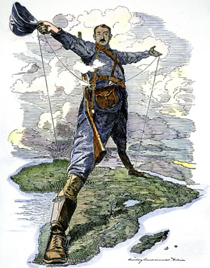
Berlin Conference: The Race for Africa
Early European interest limited to coast
Trading ports est. during Age of Ex.
Very little known of African interior
Work of Livingstone, Stanley shed light
Abundance of natural resources (rubber, ivory, diamonds), lack of political & military strength in many cases
The Race for Africa
King Leopold II of Belgium’s Congo
Established nations moved in from coast; others quick to follow example
Bismarck of Germany concerned about conflict among European nations
Berlin Conference (1884) establishes colonial boundaries, ground rules for exploitation
Only Liberia & Ethiopia remain free
Characteristics of Imperialistic Rule:
Direct Rule: replace existing government
Indirect Rule: control existing government
This cartoon depicts British businessman & politician Cecil Rhodes. Rhodes led the cries for British imperialism in Africa and made a fortune building diamond mines in what is today Zimbabwe.

Slide 7
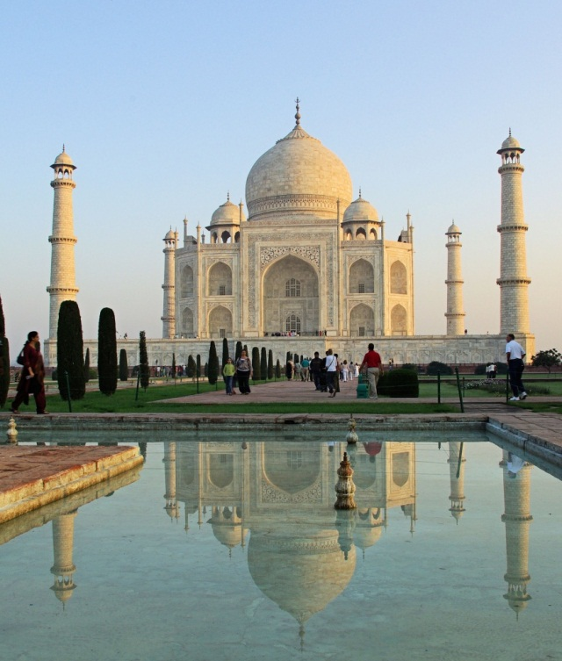
Raj: British Imperialist Rule in India
British traders challenged Mogul Dynasty
1757: Forts built to protect European interests
Britain limited French trade, empowered East India Company authority to act on its behalf
Sir Robert Clive built army to destroy any threat to East India Company’s power in India
Collecting taxes became EIC’s major income
1867: Sepoy Mutiny caused Parliament to hand power from EIC to Queen Victoria
Indian troops turned on British officers, Brits crushed rebellion, both sides commit atrocities
Victoria created post of viceroy to govern India directly
Benefits of “Raj” (1858-1947)
Order & stability, education (only for elite), increased technology, infrastructure
Costs of Raj
Economic hardship, hunger for most, degrading treatment by British
The most known symbol of the Mogul Dynasty is the Taj Mahal (below). Above is the flag of the British East India Company.

Slide 8
Would you rather only be able to listen to Nickelback songs for the rest of your life
or read all 56 pages of Apple’s Terms and Conditions every day for the rest of your life?

Slide 9
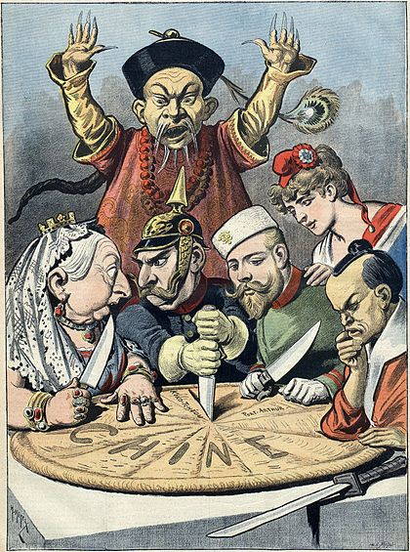
Imperialist Policies in the Far East
China’s Opium War (1839)
British traders restricted to single port
Huge British demand for tea leads to debt to China (paid in silver)
Brits begin importing Opium into China
Highly addictive illegal drug from India
Addiction leads to profit (paid in silver)
War breaks out, China falls to Britain
Opens door for Western Influences
China falls into political, social chaos
End to Isolation in Japan (1853)
US Commodore Perry: Gunboat Diplomacy
Veiled threat to Japan: trade or be colonized
Began massive push to modernize Japan...
Meiji Restoration aimed to strengthen Japan
Led by new Emperor Mutsuhito
Federalized, organized Japan’s government
Big emphasis on industrialization & imperialism
This cartoon depicts the global interest in gaining control of a share of the Chinese economy as well as the general racism of the era.

Slide 10
Would you rather know when you’re going to die or how you’re going to die?

Slide 11
Industry Creates New Age Of Imperialism
19th century Europeans began to view others nations as sources of _____________
Influence of industrial capitalism principles
Manufactured goods traded for resources
____________________: the extension of a nation’s economic/political power over other lands
Motivations behind European Imperialism
_______________driven to control others by profit
Greater control over raw materials & markets
European rivals used empires as leverage
Colonies were viewed as sources of pride & symbols of national strength & dominance
___________________________and Racist Attitudes
Social Darwinists believed that “survival of the fittest” culture was to the benefit of mankind
Racist attitudes (believe in the superiority of certain races) were common within Europe
Humanitarian approach to Imperialism
“White Man’s _____________________” to civilize & Christianize the “savage” people of the world
Great Britain built a global empire (below) based on motivations for profit and often racist attitudes (above).

Slide 12
Berlin Conference: The Race for Africa
Early European interest limited to coast
Trading ports est. during Age of Ex.
Very little known of African _____________
Work of Livingstone, Stanley shed light
Abundance of natural resources (rubber, ivory, diamonds), lack of political & military strength in many cases
The Race for Africa
_______________________of Belgium’s Congo
Established nations moved in from coast; others quick to follow example
Bismarck of Germany concerned about conflict among European nations
_________________________(1884) establishes colonial boundaries, ground rules for exploitation
Only Liberia & Ethiopia remain free
Characteristics of Imperialistic Rule:
______________Rule: replace existing government
_______________Rule: control existing government
This cartoon depicts British businessman & politician Cecil Rhodes. Rhodes led the cries for British imperialism in Africa and made a fortune building diamond mines in what is today Zimbabwe.

Slide 13
Raj: British Imperialist Rule in India
British traders challenged ________________ Dynasty
1757: Forts built to protect European interests
Britain limited French trade, empowered East India Company authority to act on its behalf
Sir Robert Clive built army to destroy any threat to East India Company’s power in India
Collecting ________became EIC’s major income
1867: ______________Mutiny caused Parliament to hand power from EIC to Queen Victoria
Indian troops turned on British officers, Brits crushed rebellion, both sides commit atrocities
Victoria created post of _______________ to govern India directly
Benefits of “______” (1858-1947)
Order & stability, education (only for elite), increased technology, infrastructure
Costs of _______
Economic hardship, hunger for most, degrading treatment by British
The most known symbol of the Mogul Dynasty is the Taj Mahal (below). Above is the flag of the British East India Company.

Slide 14
Imperialist Policies in the Far East
China’s _____________ War (1839)
British traders restricted to single port
Huge British demand for tea leads to debt to China (paid in _____________)
Brits begin importing _____________into China
Highly addictive illegal drug from India
Addiction leads to profit (paid in silver)
War breaks out, China falls to Britain
Opens door for Western __________________
China falls into political, social chaos
End to Isolation in _______________(1853)
US Commodore Perry: ______________Diplomacy
Veiled threat to Japan: trade or be colonized
Began massive push to modernize Japan...
_________Restoration aimed to strengthen Japan
Led by new Emperor Mutsuhito
Federalized, organized Japan’s government
Big emphasis on industrialization & imperialism
This cartoon depicts the global interest in gaining control of a share of the Chinese economy as well as the general racism of the era.

