Slide 1
Political Cartoons Exercise
Draw Your Own Political Cartoon - 20 points
1. Read through this packet either individually or with a friend.
2. Choose an issue from the list below that you would like to address:
A. and/or S. Grimke
American Anti-Slavery Society
Underground Railroad
“Amalgamation” (Miscegenation)
Gag rule
M. W. Ostram
Richard M. Johnson
“separate spheres”
Female Moral Reform Society
Dorothea Dix
Horace Mann
Catherine Beecher
E. C. Stanton
Seneca Falls Convention
New York Statute of 1848
S. B. Anthony
Transcendentalism
Individualism
Emerson, Thoreau, or Whitman
Romanticism
Hawthorne or Melville responses
Shakers
Fourierism/socialism
Oneida
Mormonism
Sex in pop culture
Minstrelsy
David Walker
Nat Turner and/or Turner’s Rebellion
W. L. Garrison
T. Weld

Slide 2
3. Decide what historical (read: early to mid 1800s) viewpoint your cartoon will portray. You may portray positive or negative views of any item above, because positive and negative views of each item appeared in our history. Exercise maturity and care if portraying a sensitive topic or practicing satire.
4. Plot your cartoon. How will you portray your position, clearly communicate your ideas, and integrate AP-level historical content? Use ideas from this packet and previous classwork.
Requirements:
- one human figure (type, look, artistic style is your choice)
- meaningful use of symbolism
- meaningful use of color
- one quote integrated
- use of five other meaningful words (any type, your choice in placement)
Brainstorm on a separate piece of notebook paper. You will hand this in along with your cartoon.

Slide 3
Common Symbols Used in Political Cartoons
The following is a list of common symbols you will find in political cartoons and their meanings.
Dove | peace
Olive branch | peace, forgiveness
Vulture | preying on others, death
Buzzard | preying on others, death
Skull/Bones | death
Elephant | Republican Party
Donkey | Democratic Party
Phoenix | something new and powerful arising from destruction
Uncle Sam | U.S. Government, American people
Sphinx | a great king with absolute power
Tortoise | someone who moves slowly, a winner
Hare | someone who moves quickly, a loser
Capitol Building Dome | Congress
White House | The President
Scales, a balance | Supreme Court, justice, fairness

Slide 4
Eagle | American Government, the Constitution
Laurel Wreath | victory
Statue of Liberty | freedom
Liberty Bell | freedom
Acorn | growth, youth
Bear | strength
Chains | bondage/slavery
Dawn | beginning/hope
Fog | confusion/obscurity
Island | lost paradise/isolation
Ivy | immortality or dependence
Key | liberation/knowledge/mystery/initiation
Lightning | sudden illumination/destruction of ignorance
Oak | Strength
Ocean | the unfathomable/formlessness/ chaos/or stability
Pen | learning/knowledge/creation of destinies
Raven | bad news/death

Slide 5
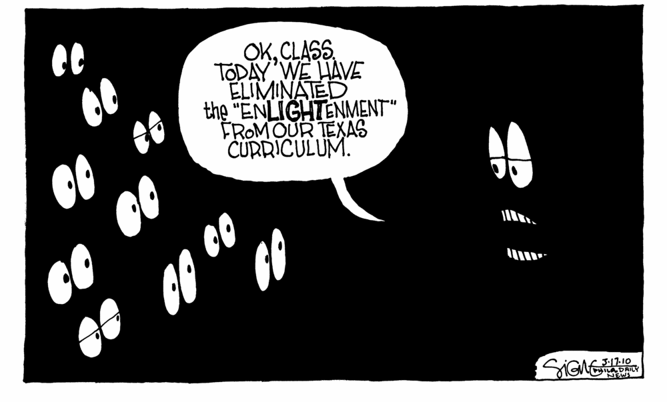
Analyzing Political Cartoons
What is a political cartoon?
Interpretive drawing, sometimes with words, that convey an idea or message about a current issue, event, or problem.
Are simple, usually black and white, graphic depictions of a news story or event.
Portray people’s attitudes about a problem or issue.

Slide 6
Common characteristics for a good political cartoon:
Wit and humor obtained by exaggeration not just for comic effect but to send a message about the character.
The cartoon must have a foundation in truth (characters should be recognizable to the viewer and the main point of the drawing must have a basis in fact, even if it conveys a philosophical or ideological bias.
The cartoon should have a moral purpose. In other words, the cartoon should provide opportunities to inform the viewer about an issue and allow for critical thinking (supporting OR refuting the cartoonist’s message.)

Slide 7
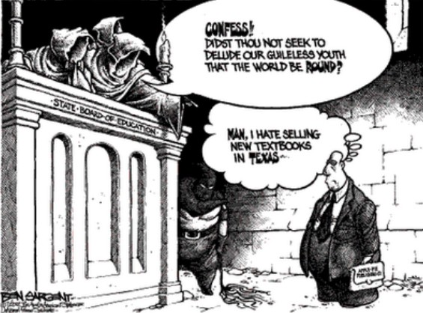
Symbolism
Cartoonists use simple objects, or symbols, to stand for larger concepts or ideas.
After you identify the symbols in a cartoon, think about what the cartoonist intends each symbol to stand for.

Slide 8
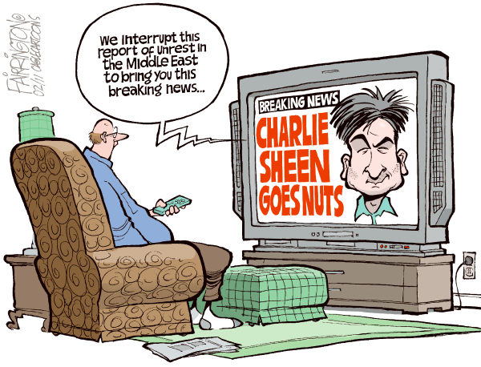
Exaggeration
Sometimes cartoonists overdo, or exaggerate, the physical characteristics of people or things in order to make a point.
When you study a cartoon, look for any characteristics that seem overdone or overblown. (Facial characteristics and clothing are some of the most commonly exaggerated characteristics.) Then, try to decide what point the cartoonist was trying to make through exaggeration.

Slide 9
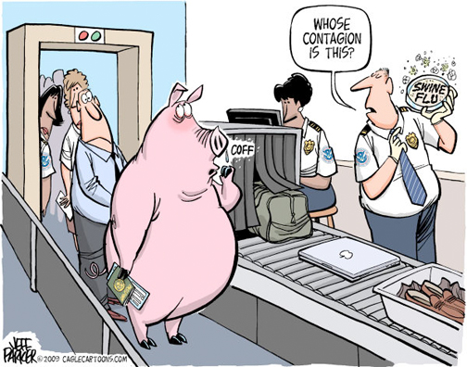
Labeling
Cartoonists often label objects or people to make it clear exactly what they stand for.
Watch out for the different labels that appear in a cartoon, and ask yourself why the cartoonist chose to label that particular person or object. Does the label make the meaning of the object more clear?

Slide 10
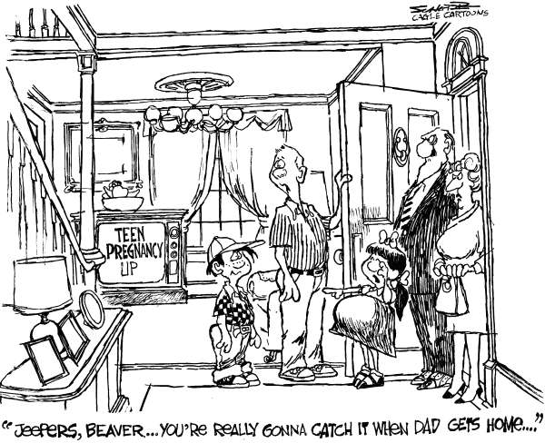
Analogy
An analogy is a comparison between two unlike things that share some characteristics. By comparing a complex issue or situation with a more familiar one, cartoonists can help their readers see it in a different light.
After you’ve studied a cartoon for a while, try to decide what the cartoon’s main analogy is. What two situations does the cartoon compare? Once you understand the main analogy, decide if this comparison makes the cartoonist’s point more clear to you

Slide 11
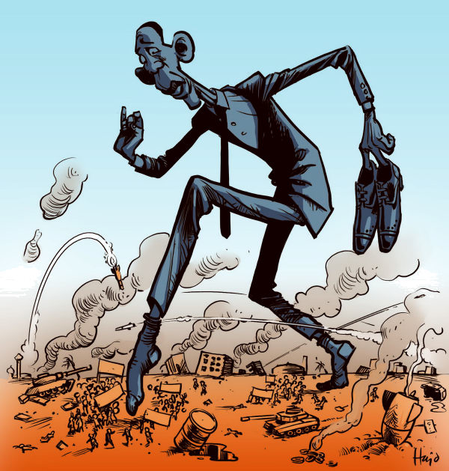
Irony
Irony is the difference between the ways things are and the way things should be, or the way things are expected to be. Cartoonists often use irony to express their opinion on an issue.
When you look at a cartoon, see if you can find any irony in the situation the cartoon depicts. If you can, think about what point the irony might be intended to emphasize. Does the irony help the cartoonist express his or her opinion more effectively?

Slide 12
OPTICS Strategy
O - Conduct a brief overview of the visual or graphic. “float” over the image. What is the primary focus?
P – Key in on the parts of the visual by reading all labels and noting any elements or details that seem important. What is the interaction of the parts with the primary focus?
T – Read the title of the visual so that you are clear on the subject it is covering. Does the title make sense? If there is no title – What would you call it?

Slide 13
OPTICS continued
I – Use the title as your theory and the parts of the visual as your clues to detect and specify the interrelationships, to infer or interpret – What is not in the picture, but implied?
C – Draw a conclusion about the visual as a whole. What is it all about? Can you summarize in one sentence?
S – What is the source? Where did it come from? What is the bias / political leaning of the source? What is the audience? What is the context?

Slide 14
Some questions to ask yourself:
What issue is this political cartoon about?
What is the cartoonist’s opinion on this issue?
What other opinion can you imagine another person having on this issue?
Did you find this cartoon persuasive? Why or why not?
What other techniques could the cartoonist have used to make this cartoon more persuasive?

Slide 15
More info
Powerful people are usually fat, large people
Weak people are usually skinny, small people
Green – environmental
Red – communist
Good guys usually wear white
Bad guys usually wear black

Slide 16
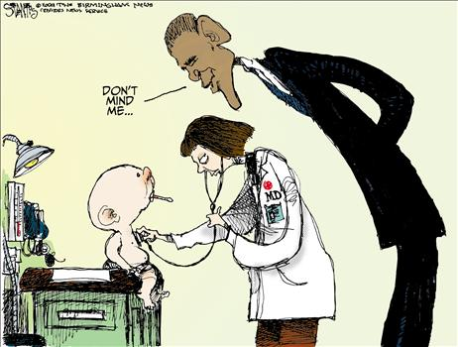
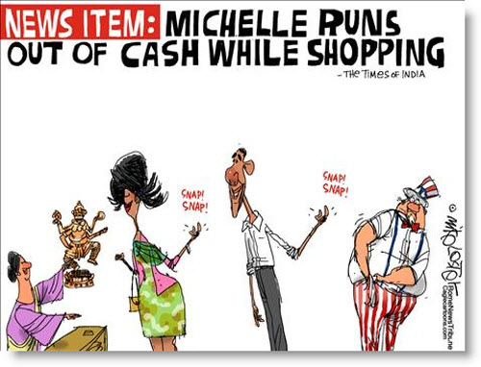
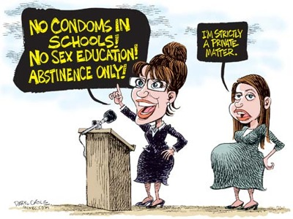
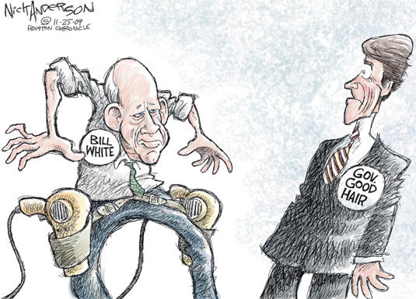
President Obama
Michelle Obama
Sarah Palin
Gov. Perry

Slide 17
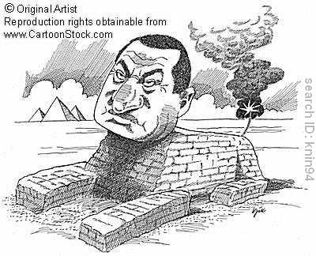
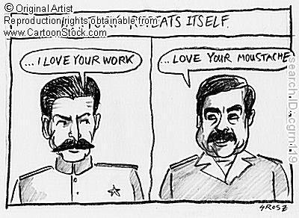
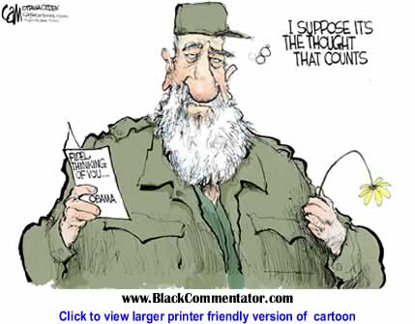
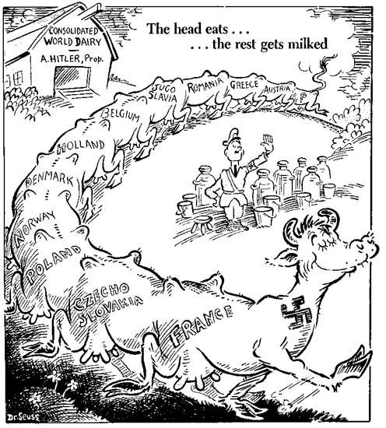
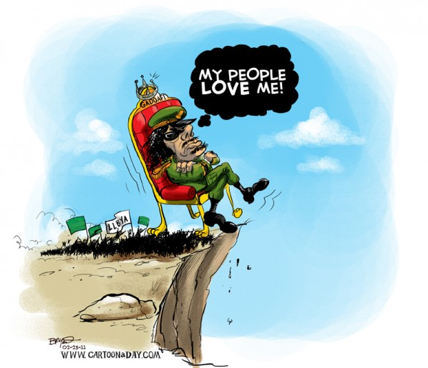
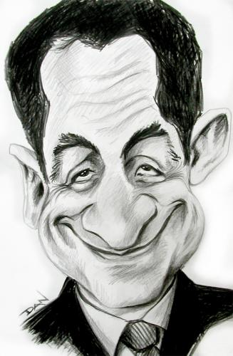
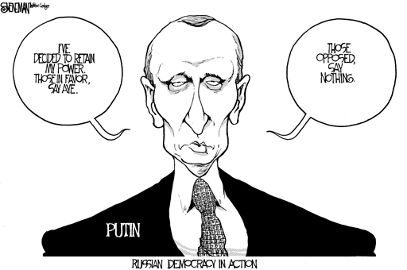
Other People
Mubarak
STALIN HUSSEIN
Hitler
CASTRO
Gadaffi
Sarkozy

Slide 18
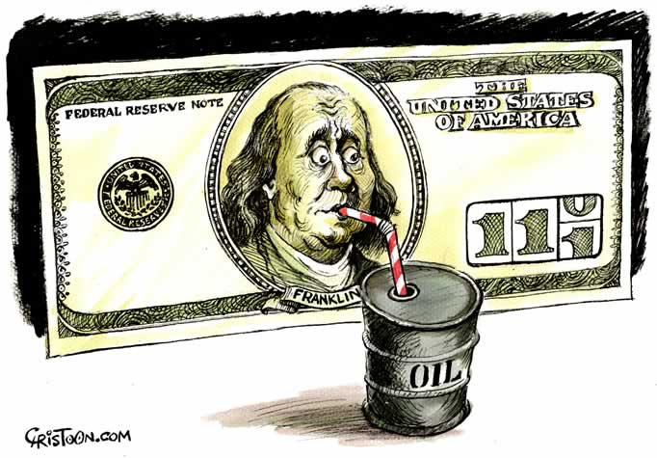
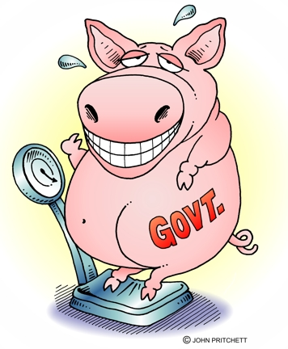
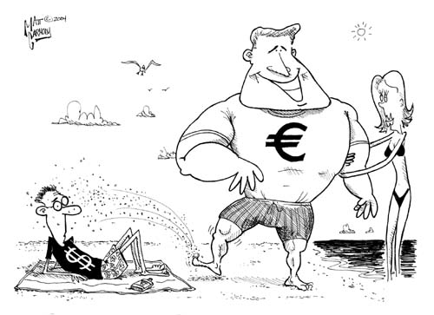
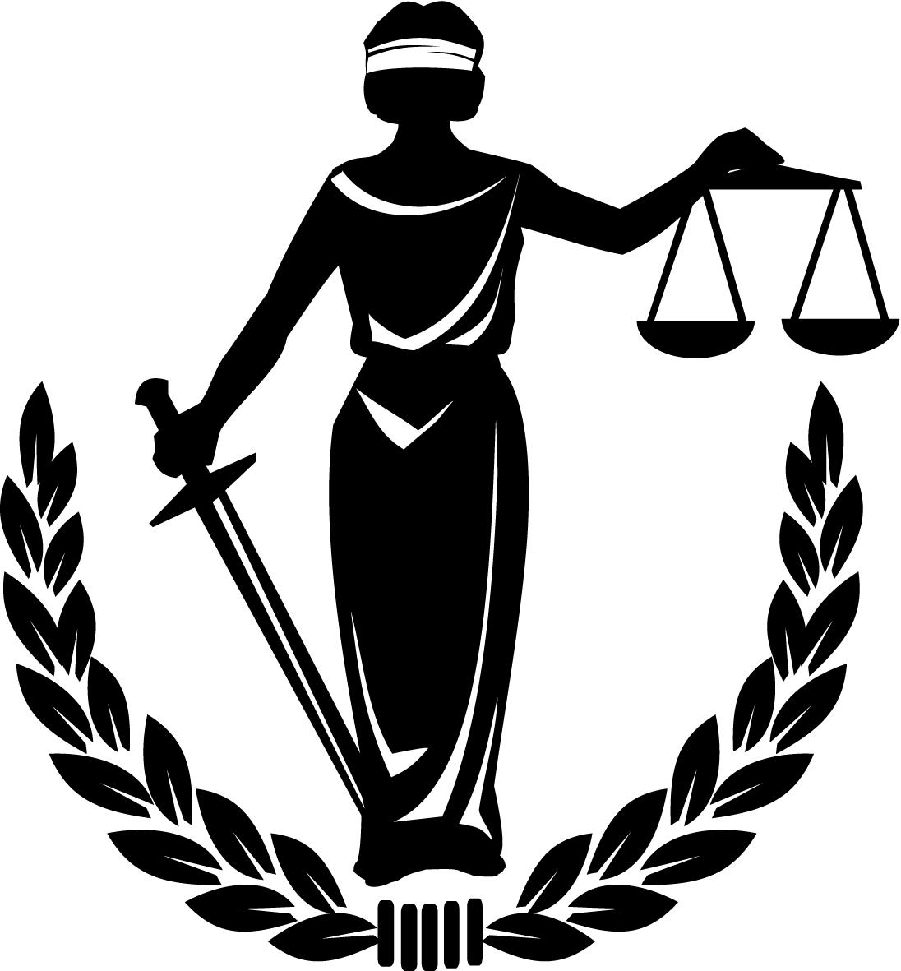
Symbols
Female & male
Pork barrel – waste
Money
Communism
justice

Slide 19
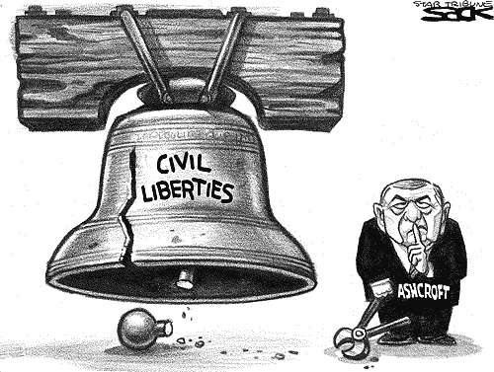
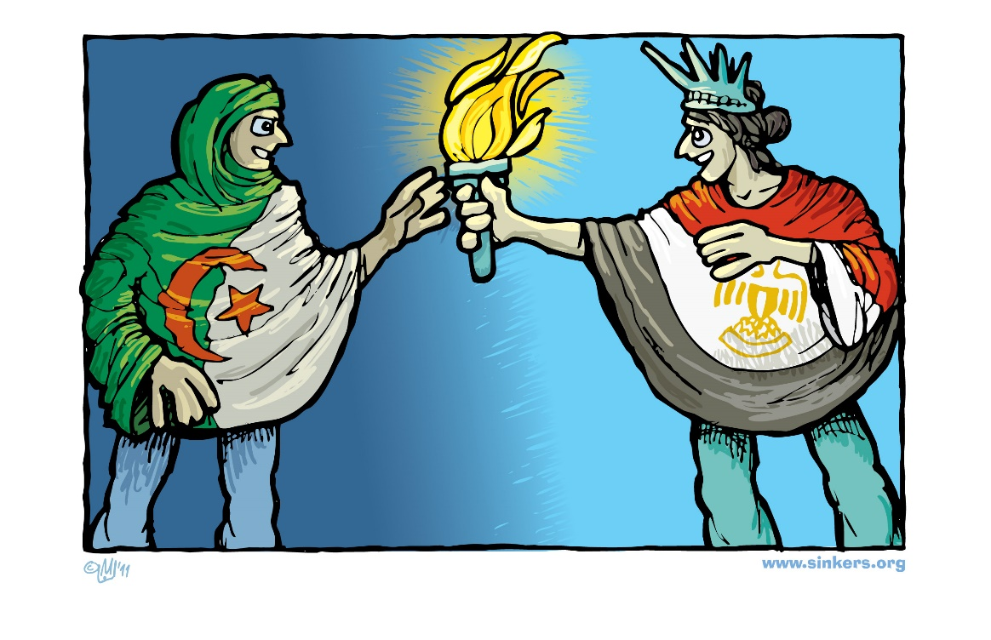
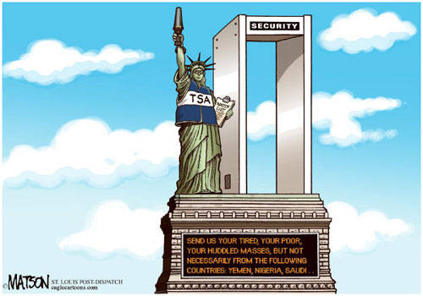
Liberty, freedom and democracy:
Torch
Liberty Bell
Statue of Liberty

Slide 20
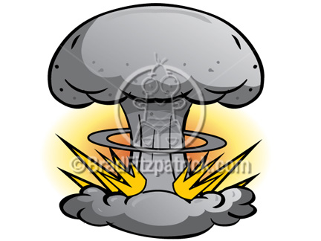
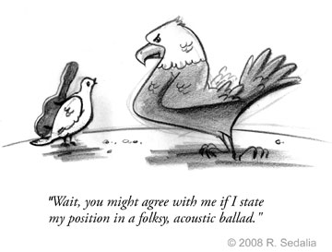
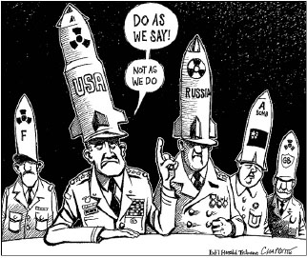
Peace and War
Peace – dove, laurels, peace fingers or peace sign
War – hawk, bomb, missiles

Slide 21
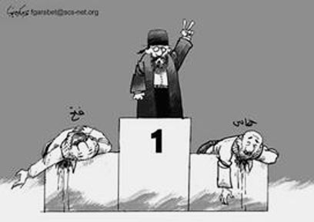
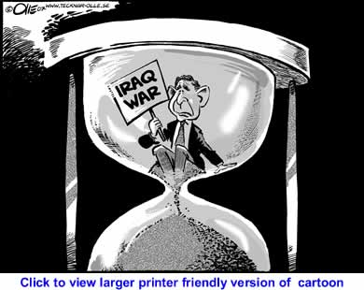
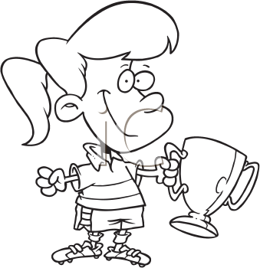
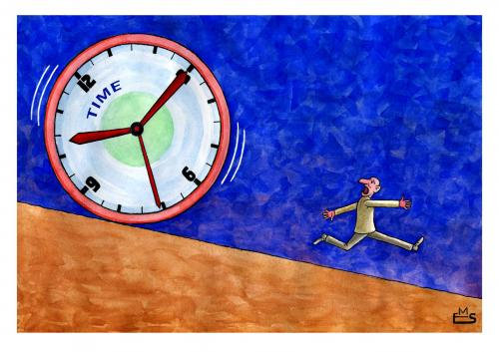
Time and Victory
Time – clock or hourglass
Victory – victory fingers, trophy, or wreath of laurels

Slide 22
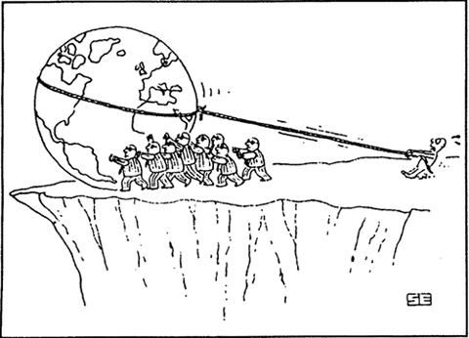
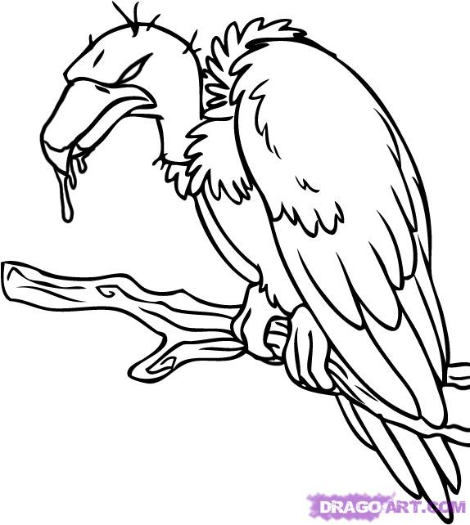
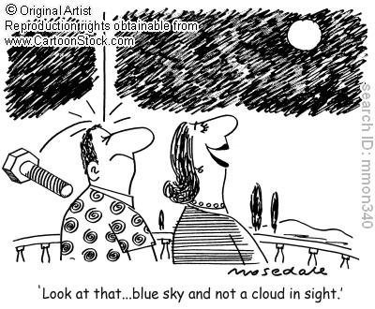
Death & Danger
Falling objects
Vultures
Scull & crossbones
cliffs

Slide 23
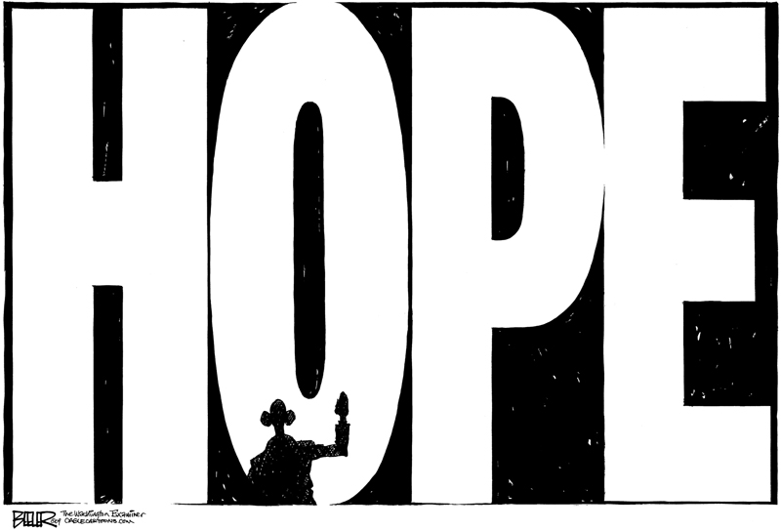
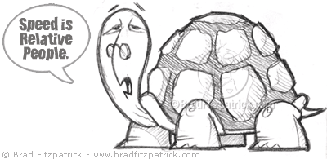
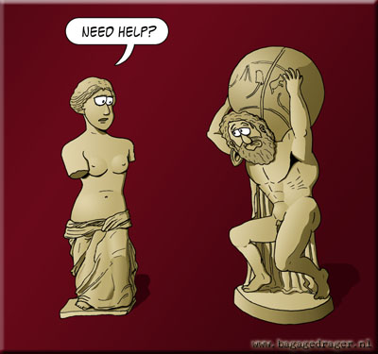
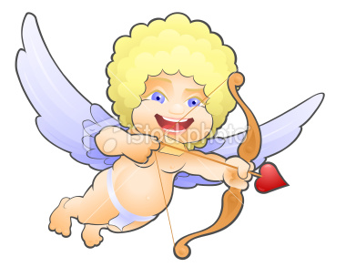
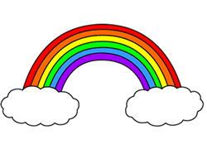
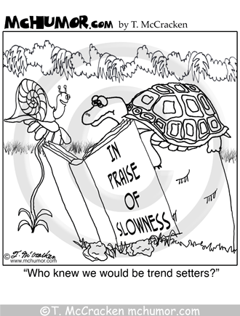
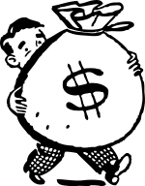
Slow – snail, turtle
Love – heart, cupid, venus
Hope – rainbow, smiley
Wealth – money bags

Slide 24
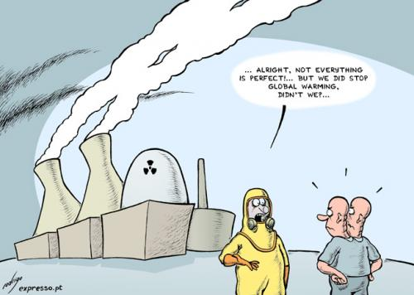
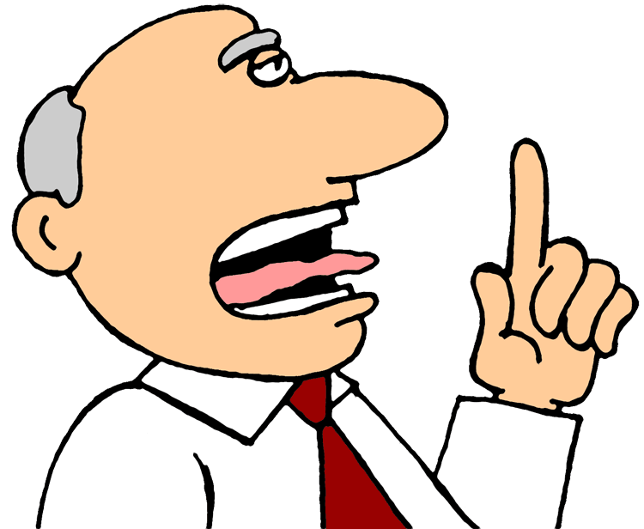
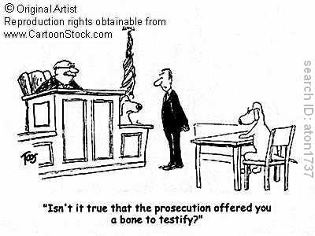
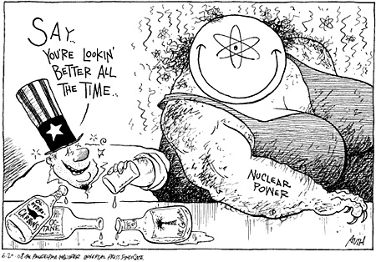
Nuclear
Ballot box
Court
Police
politician

Slide 25
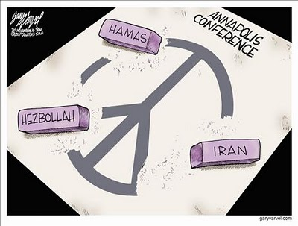

Slide 26
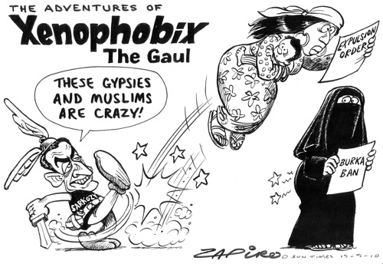

Slide 27
