Slide 1
World War I & the Aftermath
In Flanders fields the poppies blow Between the crosses, row by row, That mark our place; and in the sky The larks, still bravely singing, fly Scarce heard among the guns below. We are the dead. Short days ago We lived, felt dawn, saw sunset glow, Loved, and were loved, and now we lie In Flanders fields. Take up our quarrel with the foe; To you from failing hands we throw The torch; be yours to hold it high. If yea break faith with us who die We shall not sleep, though poppies grow In Flanders fields.
- Lt. Col. John McCrae, 1914
Unit 3 – Spring 2012 – Modern World History

Slide 2
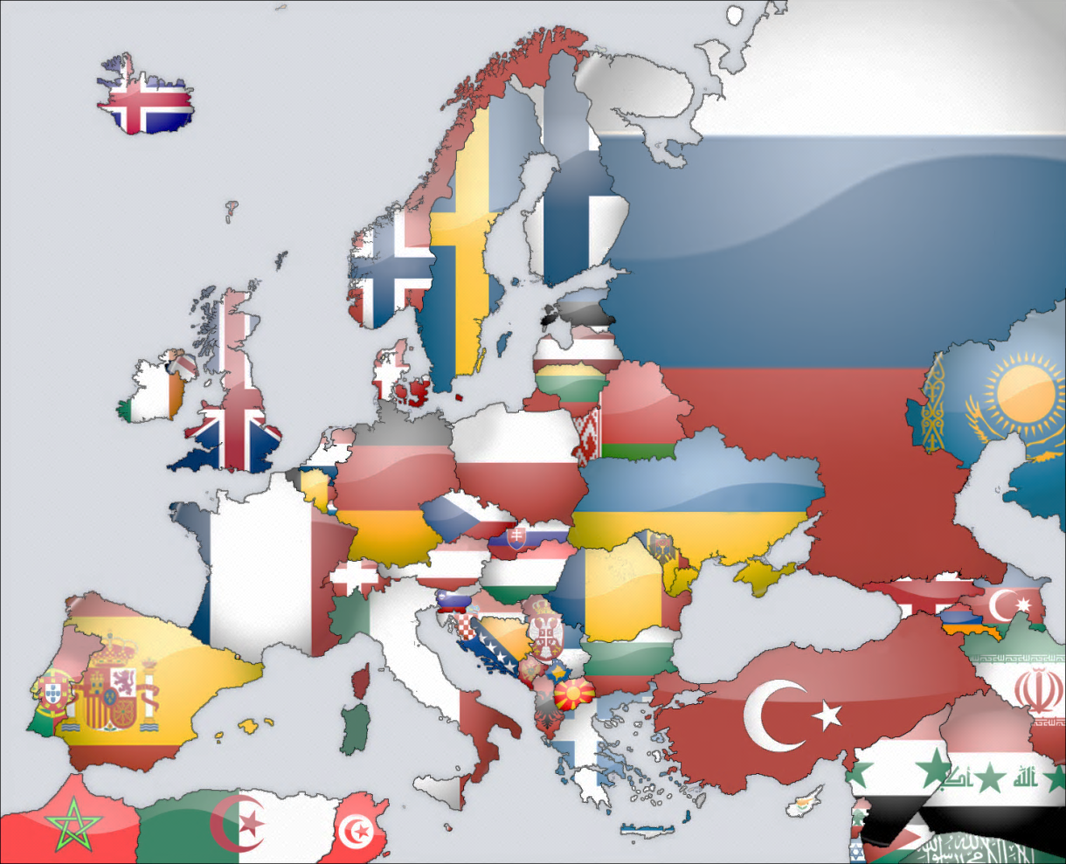
Nationalism Creates a Climate of Conflict
Major Causes of the Great War (WWI)
Growing sense of nationalism in 19th century boiled over into intense rivalries and fierce tensions between European cultures.
These sentiments manifested themselves through militarism, where industrialization and nationalism led to huge, industrialized standing armies across Europe.
Imperialism—especially within Africa—created competition and bad blood between European powers.
A web of secret and not-so-secret alliances between Europeans leaders caused the Continent to divide into rival camps.
Modern-day Europe is a patch-work of nation-states, large and small. Each nation has developed a unique society and government based on their own culture heritage.

Slide 3
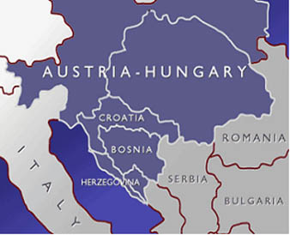
On the Eve of War: The Balkan Powder-Keg
Balkans: wooded, mountainous region of south-central Europe characterized by many diverse cultural groups
Serbians, Bosnians, Croatians, Greeks, & more
Ethnically, most Balkans considered “Slavic”
Imperialism & nationalism created tense situation known as “Balkan Powder Keg”
Austria-Hungary & Russia both had interest in controlling Balkans to improve their economies
Some Slavic cultures demanded independence, others called for unification (Pan-Slavic mov’t)
Austria-Hungary annexed Bosnia in 1908, angering both neighboring Serbia and fellow-Slavic power Russia
Allies of A-H & RUS now mixed-up in Balkans
Prior to World War I, the Austrian-Hungarian Empire looked to annex the nations of the Balkans which had recently united to gain independence from the Ottoman Empire.

Slide 4
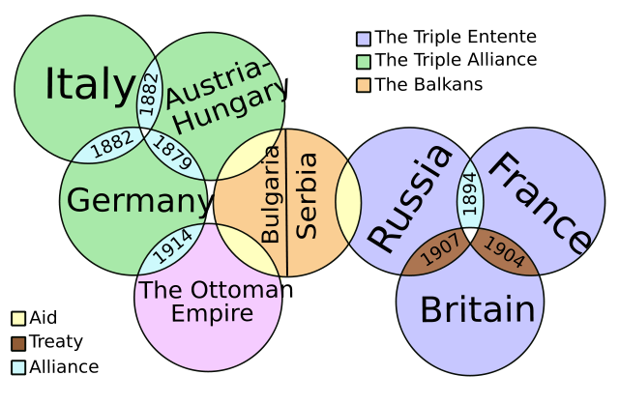
System of Alliances Prior to World War I

Slide 5
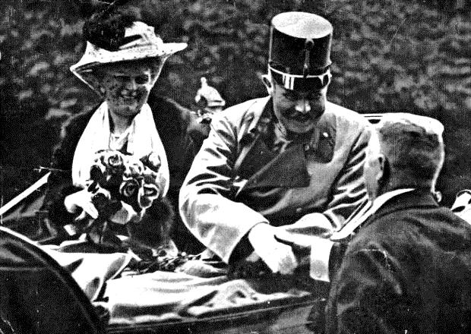
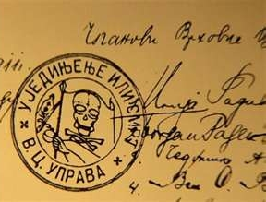
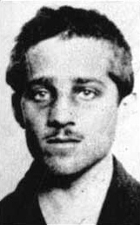
An Act of Terror Ignites the Great War
Heir to Austro-Hungarian throne, Archduke Ferdinand, assassinated in Sarajevo
Shot by Serbian nationalist Gavrilo Princip, 19
Plot organized by Black Hand (aka Unification or Death, secret pan-Slavic Serbian military society)
Designed to end A-H’s interest in Balkan nations
After heated diplomatic exchanges, A-H declared war on Serbia on July 28, 1914
Central Powers: Germany, A-H, Bulgaria, Turkey
Advantages: Superior German army, better geographic location & mobility b/c railroads
Strategy (“Schlieffen Plan”): Focus on the Western Front pushing through Belgium to capture France
Allied Powers: France, Russia, United Kingdom
2 to 1 advantage in men & resources, stronger navy
Strategy: Force GER to fight on two fronts at once
The Archduke and his wife Sophia (above) were shot by Princip (lower right) in a plot orchestrated by a shadowy organization of former Serbian army personnel known as the Black Hand, whose seal appears on the letter below.

