Slide 1
Art Imitates Life
Understanding the Renaissance through Art
Adapted from www.teachersfirst.com

Slide 2
“Art imitates life.”
What are some modern forms of art?
Do any of these represent life for people in the United States? Explain.
Where do artists get ideas (inspiration) for their work?

Slide 3

What clues does this picture give to what was important to people from this time?

Slide 4
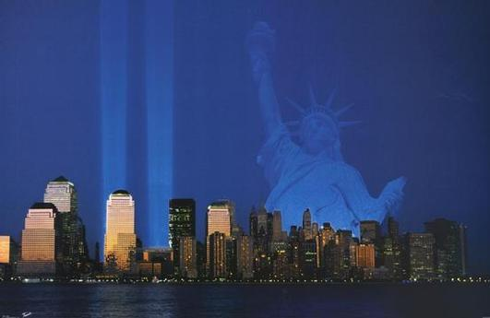
What clues does this picture give to what was important to people from this time?

Slide 5
Now, in your notes, write a concluding statement about what we’ve discussed.
How would you summarize this
in 1-2 sentences?

Slide 6
Next, share your response with a shoulder partner.

Slide 7
Re-cap…
In the 1300s, the period known as the Middle Ages was coming to an end. People throughout Europe began to realize that institutions like feudal governments and the Catholic Church were not all powerful: they had failed repeatedly to maintain peace and to provide for a continent ravaged by the Black Death.
As a result, Europeans began to question these institutions and the underlying assumptions which kept them in power.

Slide 8
Recap: In addition, the Crusades had introduced Europe to trade routes and new goods from Asia. The resulting increase in commerce led to a wealthier, more powerful merchant class in Europe.
Members of this middle class spent their fortunes on works like new schools, magnificent buildings, paintings, and sculptures, much of it intended for public enjoyment. Such extravagant public displays of wealth helped to raise the status of any merchant who chose to become a patron of the arts.
The term renaissance literally means “rebirth.” This was a period in Europe when major change was taking place. In many ways, it was the rebirth (return) of Europe as it had been during the days of Ancient Greece and Rome. Trade increased, merchants became wealthy, new learning took place, interest in the arts blossomed, and towns and cities grew.
The Renaissance also had four main intellectual characteristics: humanism, individualism, Classicism, and secularism.

Slide 9
If art truly does imitate life, it should be possible to find examples of the Renaissance characteristics in artwork from that time period.
Analyze the following Renaissance painting School of Athens by Raphael. Describe evidence of each characteristic as it appears in the painting. (Write the following definitions, as well as your explanation for how each is or is not represented in School of Athens, in your notes.)
Humanism: Studying topics related to humans, their accomplishments, and their potential. (The humanities are subjects like art, philosophy, history, English, etc.)
Individualism: Belief in the unique qualities of every human being. This idea emphasizes the worth of every human being and celebrates diversity.
Classicism: Having an interest in the art and learning of Ancient Greece and Rome.
Secularism: Non-religious subject matter and themes
Additionally, answer: Does this painting look realistic? Why or why not?

Slide 10
(Plato and Aristotle)

Slide 11
How does what you think compare with your classmates’ ideas?
You will be numbered off into groups of four to discuss each characteristic.
You are graded on authentic participation.

Slide 12
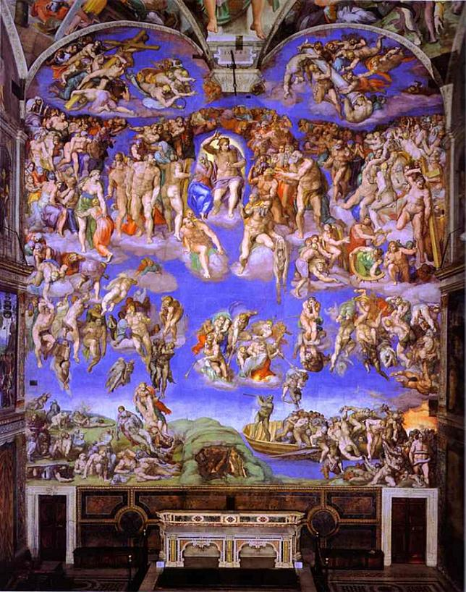
“The Last Judgment was an object of a heavy dispute between Cardinal Carafa and Michelangelo: the artist was accused of immorality and intolerable obscenity, having depicted naked figures, with genitals in evidence, inside the most important church of Christianity, so a censorship campaign (known as the "Fig-Leaf Campaign") was organized by Carafa and Monsignor Sernini (Mantua's ambassador) to remove the frescoes. When the Pope's own Master of Ceremonies, Biagio da Cesena, said "it was mostly disgraceful that in so sacred a place there should have been depicted all those nude figures, exposing themselves so shamefully, and that it was no work for a papal chapel but rather for the public baths and taverns," Michelangelo worked da Cesena's semblance into the scene as Minos, judge of the underworld. It is said that when Cesena complained to the Pope, the pontiff responded that his jurisdiction did not extend to hell, so the portrait would have to remain.”
http://www.artinthepicture.com/paintings/Michelangelo/The-Last-Judgment/

