Slide 1
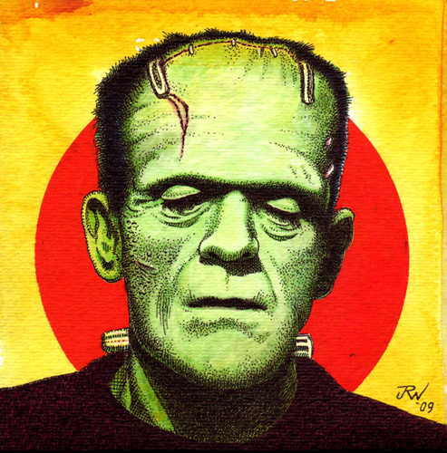
Forces of Change in Europe, and then…
Clue:

Slide 2
Section 2-1
Reaction and Revolution (Sec. 2)
Main Idea:
The great powers worked to maintain a conservative order throughout Europe. ←
Key Terms:
conservatism ←
liberalism ←
universal male suffrage
principle of intervention ←
Click the mouse button or press the Space Bar to display the information.

Slide 4
Section 2-39
Critical Thinking
Analyze How did the social and economic changes from the Industrial Revolution contribute to the spread of liberalism?
Click the mouse button or press the Space Bar to display the answer.

Slide 5
Section 2-39
Critical Thinking
Analyze How did the social and economic changes from the Industrial Revolution contribute to the spread of liberalism?
The Industrial Revolution led to the growth of an industrial middle class. Liberalism was tied to middle-class men.
Click the mouse button or press the Space Bar to display the answer.

Slide 6
Culture: Romanticism (Sec. 4)
Main Idea
At the end of the eighteenth century, romanticism emerged as a reaction to the ideas of the Enlightenment. ←

Slide 7
Romanticism
At the end of the eighteenth century, the intellectual movement known as romanticism emerged in reaction to Enlightenment ideas.
The Enlightenment had stressed reason for discovering truth. The romantics emphasized feelings and imagination as sources of knowing.

Slide 8
Romanticism (cont.)
For romanticism, emotions were truly knowable only by the person experiencing them.
Romantic works often feature figures isolated from society but sure about the worth of their inner lives, and what is right and wrong (morality).
Romanticism also stressed individualism, the belief that each person is unique.
Many romantics rebelled against middle- class conventions.

Slide 9
Romanticism (cont.)
Many romantics also had a deep interest in the past and revived medieval architectural styles, such as the Houses of Parliament in London.
Sir Walter Scott’s novel of clashes among medieval knights, Ivanhoe, was wildly popular.

Slide 10
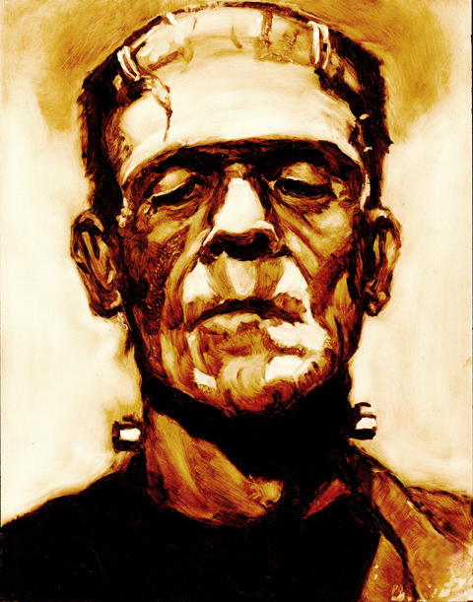
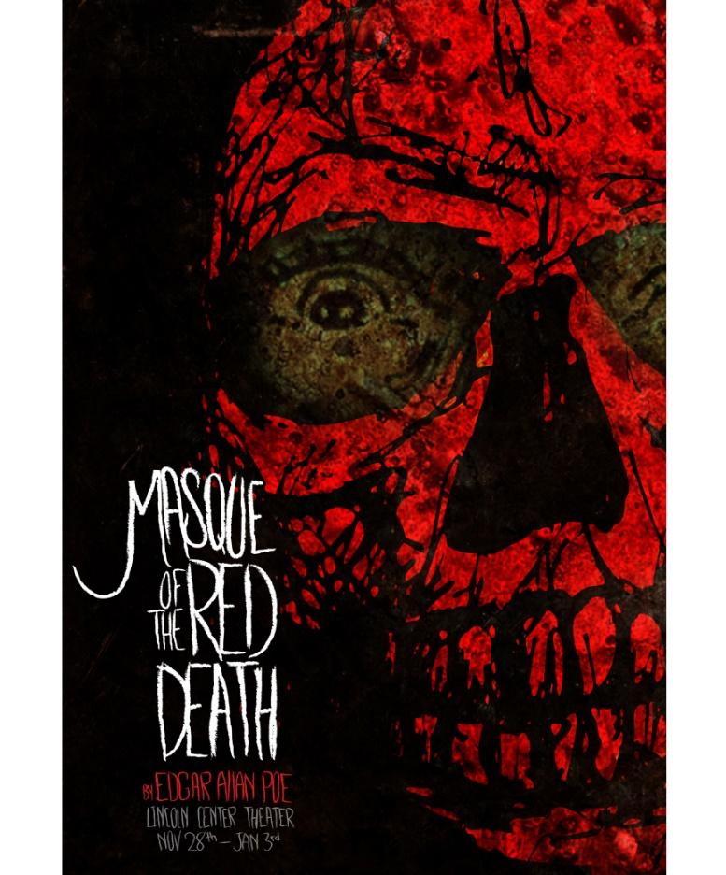
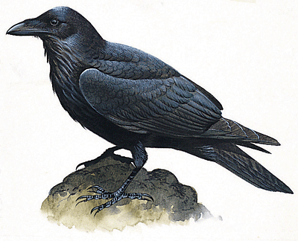
Section 4-10
Romanticism (cont.)
The exotic, unfamiliar, and extreme attracted romantics, as is seen in Gothic literature such as Mary Shelley’s Frankenstein and the works of Edgar Allen Poe.
(pages 605–607)

Slide 11
Romanticism (cont.)
Romantics viewed poetry as the direct expression of the soul.
Romantic poetry also expressed the love of nature.
This is seen in the poetry of William Wordsworth.
The worship of nature caused romantics to criticize the new science, which they believed reduced nature to a cold object of mathematical study that had no room for imagination or human soul.

Slide 12
Section 4-12
Romanticism (cont.)
In Shelley’s novel, Frankenstein’s monster symbolized the danger of science’s attempt to conquer nature.
Romantics feared that industrialization would alienate people from their inner selves and the natural world.
Romantic artists shared two basic beliefs: - art reflects the artist’s inner soul - art should abandon classical reason for warmth and emotion

Slide 13
Now, it’s time for you to experience some Romance!
(Who said history class is never fun?!)
We will read “Hop-Frog,” by Edgar Allen Poe.
You may read it aloud in a group (with designated readers), or you may read it individually.
Answer the following questions as you go, in your notes:
How did Hop-Frog get his name?
Why did Hop-Frog take the wine from the King?
Why did Hop-Frog do what he did at the end of the story?

