Slide 1
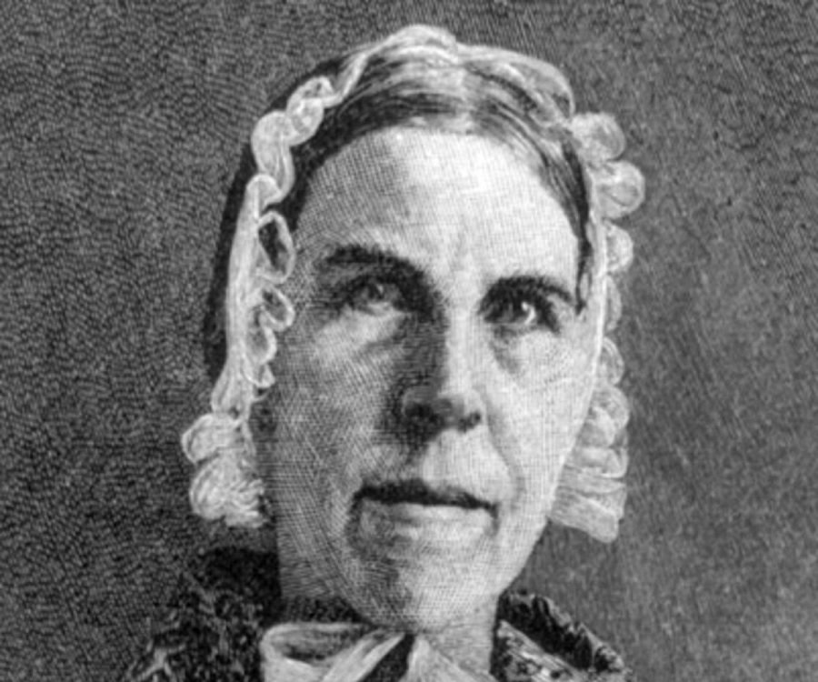
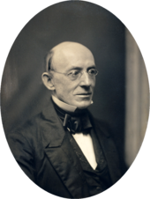
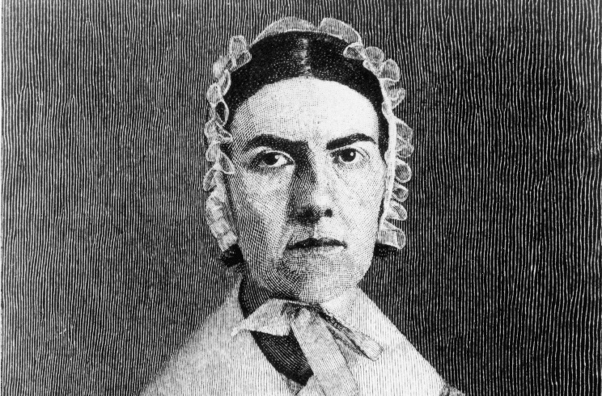
“I WILL BE HEARD”
EARLY RADICALISM:
WILLIAM LLOYD GARRISON
ANGELINA GRIMKE
SARAH GRIMKE

Slide 2
Document Pairing: Step One
Gather into groups according to the suit on your card
Complete the following readings and questions individually, referring to group mates only an necessary for right now
“Angelina and Sarah Grimke: Abolitionist Sisters,” by Carol Berkin
Read and answer three questions at beginning of source
Write one additional question for discussion on the text
William Lloyd Garrison on Slavery (p. 224 in sourcebook)
Answer #1 and #3 on notebook paper
Write one additional question for discussion

Slide 3
Document Pairing: Step Two
The person with the Ace is the discussion leader. (You may trade cards if you wish.)
Starting with the Grimke document, share out your answers and questions for discussion.
Then, move to Garrison, and share out your answers and questions for discussion.

