Slide 1
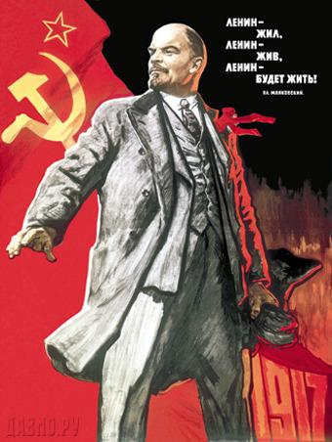
Lenin and the Russian Revolution
Absolutist Russia led by Czar Nicholas II
Despite his complete lack of training, czar insisted on leading Russian military effort
Woefully ill-equipped army lacked weaponry
Public lost confidence in royal leadership
Odd story of Czarista Alexandra & Rasputin
Demonstrators in Petrograd protest breadlines
March Revolution: czar forced to step down, shot
Vladimir Lenin and the Bolshevik Party
Russian Marxists dedicated to violent revolution
Lenin: controlling “soviets” key to taking power
October (1918) Revolution: Bolsheviks marched on St. Petersburg’s Winter Palace, seized power
Bolsheviks renamed Communists, survived internal & external attacks to create USSR
This Soviet propaganda poster reads “Lenin Lived, Lenin Lives, Lenin Will Live”, suggesting the lasting legacy of Lenin among the Soviet people.

Slide 2
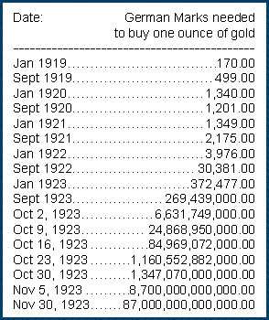
Economic Hardships: From Bad to Worse
1920s: Uneasy Peace & Uncertain Security
League of Nations left weak without USA
Congress refused to approve Treaty of Versailles
Remaining members mixed about use of force
Germany unable to pay reparations to France
Led to French occupation of industrial Ruhr Valley
Inflation crippled German economy, democracy
Dawes Plan introduced to settle economic dispute; American help/loans to Germany
1929: Great Depression erodes economies
Caused by economic downturn in individual national economies, international financial crisis
Prices fell rapidly due to overproduction
Underconsumption due to falling wages
US investors had been propping up European economies, much of that capital lost in Crash
Extreme unemployment led to growing tensions, criticism of the democracy & free-market system
The chart above demonstrates the tremendous inflation that crippled the Germany economy in the years following the Treaty of Versailles.

