Slide 1
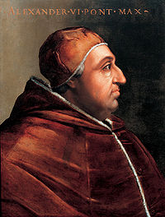
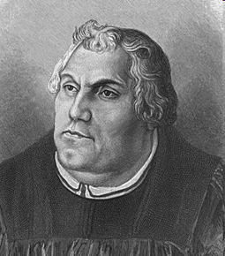
The Reformation, cont’d
Corruption of Catholic Church
Clergy focused on non-spiritual duties
Salvation through indulgences
Money or relics
Forgiveness for some or all of sin
Selling indulgences = buying salvation
Luther & his Ninety-Five Theses
Disgusted German monk & professor
Drew on works of Erasmus, who also wanted reform
Stunning attack on church practices
Excommunicated, 1521
Rise of Lutheranism (Protestantism)
Simplification of Christian worship
“Justification by faith alone”
Individual relationship with God and the Bible
Why did so many follow Luther?
Gave the poor hope, dignity, meaning to life
The rich & powerful could gain more power: why?
Impact of the Gutenberg printing press
Vernacular

Slide 2
“If we punish thieves with the gallows, robbers with the sword, and heretics with fire, why do we not all the more fling ourselves with all our weapons upon these masters of perdition, these cardinals, these popes, and all this stink of [Catholic] sodomy that ceaselessly corrupts the church of God and wash our hands in their blood so that we may free ourselves and all who belong to us from this most dangerous fire?” ~ Martin Luther, 1521

Slide 3
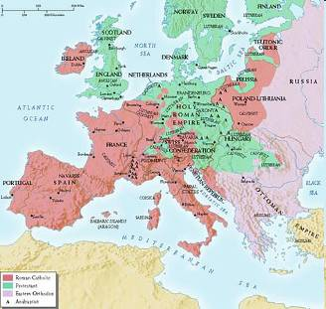
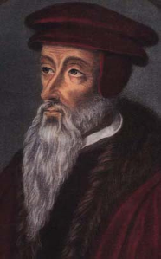
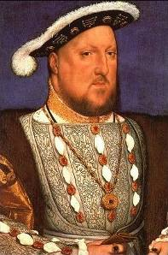
The Reformation, cont’d
The Wars of Religion
Protestant German Princes vs. Catholic HRE Charles V
Peace of Augsburg (1555)
Princes could choose their religion
Lutheranism was a way for princes to exercise self-sovereignty
John Calvin and the Calvinists
Reformed church of Geneva in 1520s
Based on a literal reading of scriptures
Predestination: Your fate is determined before you’re born
Became more popular than Lutheranism
Henry VIII of England
Wanted an annulment of his marriage
Had mistress, no male heir to throne
Church of England became Protestant
Five more marriages, one sickly son
“Anglican Church”

Slide 4
Catholic Reformation (aka counter-reformation)
By the 1500s the Catholic Church lost power to Lutheranism, Calvinism, and the Church of England.
Three ways of gaining strength back:
The Jesuits (beg. In 1530s)
Founded by Ignatius of Loyola
Swore obedience to Pope
Use of education to spread message

Slide 5
Catholic Reformation (aka counter-reformation)
2. Reform of the papacy (beg. 1530s)
Protestant Reformation jolted the Catholic Church into action
Reform Commission begun by Pope Paul III
Commission blamed problems on corruption
Commission also started…
3. The Council of Trent (beg. 1545)
Reaffirmed faith and good works necessary to be saved; preserved Catholic beliefs about worship service; and use (but not sale) of indulgences
Led to a clear plan of unified action; strengthened the Catholic
Church

