Slide 1
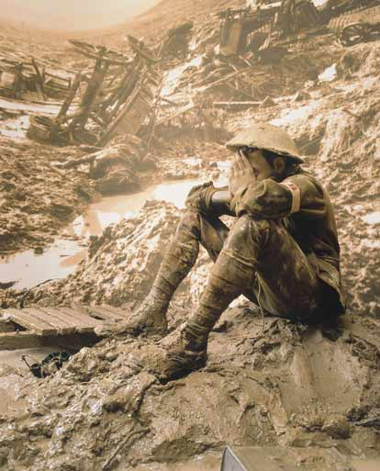
The First World War: 1914-1918 (Alliance Video)
Stalemate: The Western Front
After an initial advance by the central powers into France, both sides dug in miles outside Paris (First Battle of the Marne)
Trench warfare: fighting from ditches protected by machine gun and barbed wire (400+ miles long)
Life in trenches: horrible but not continual
“No Man’s Land”: between opposing trenches
Front did not move more than 10 mi. for 3 years
War of attrition
Italy peaces out (figuratively—moves to the T.E.)
Transition from “gentleman’s war” to modern warfare
Christmas Truce of 1914
Not shelling the enemy’s latrines or breakfasts
Uniforms
Corlett, Peter. Man in the Mud. Australian War Memorial. Diorama. 1986.

Slide 2
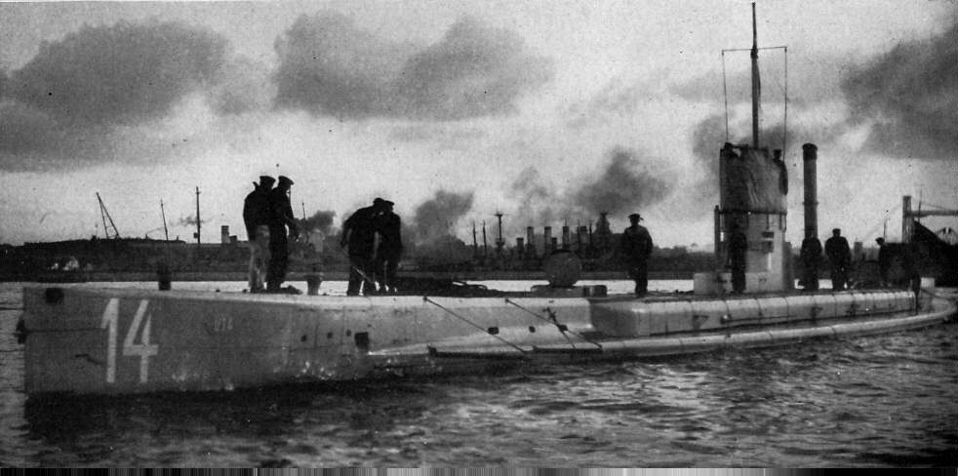
The First World War cont’d
The War at Sea
UK naval blockade broken by GER submarines
GER unrestricted submarine warfare led sinking of merchant & passenger ships without warning (Lusitania and others)
The Eastern Front: marked by mobility
Battle of Tannenberg (1914): Russia dominated by superior weaponry & leadership of Germans
Russia continued to suffer huge losses thru 1917

Slide 3
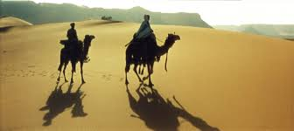
The First World War cont’d
Ottoman Empire and Gallipoli Campaign: Allies defeated (short: http://www.history.com/topics/world-war-i/battle-of-gallipoli/videos/allies-launch-disastrous-attack-at-gallipoli?m=528e394da93ae&s=undefined&f=1&free=false)
Middle East: Lawrence of Arabia
British forces from India, Australia, and New Zealand participate; Ottoman falls in 1918
Japan and Australia pick off German colonies in Pacific

Slide 4
The First World War (cont.)
Modern Warfare: Rise of War Machines
Machine guns, armored tanks, grenades, artillery cannons, submarines, poison gas & gas masks, armed airplanes & blimps
The Role of the United States
Began the war as officially neutral, attempted to sell goods to both Germany & United Kingdom
US joined Allies due to German hostile acts
Fervor over sinking of US merchant ships, Lusitania
Zimmerman Note intercepted, US public outraged
Unrestricted submarine warfare ultimately drove US to war
US declared war on Germany in April, 1917 providing fresh supply of men, money, morale
Marked steady advance of Allies toward Berlin
Germany surrender on November 11, 1918
Deaths: RUS 1.7mil, GER 1.6mil, FRA 1.3, UK 900k, A-H 800k, ITA 400k, Turkey 325k, USA 49k
Headstones of unknown Allied soldiers in Belgium

Slide 5
WWI Theater
Technological changes: building the best war machine possible

Slide 6
For your optional viewing pleasure…
WWI Uncut: Trenches and Barbed Wire (11 m)
https://www.youtube.com/watch?v=OBLZjBaNrFw
WWI Uncut: Surviving the U-Boats (9)
https://www.youtube.com/watch?v=uzaa_RVwYSs
Weapons of World War I: Flamethrowers, Poison Gas, Machine Guns (4)
https://www.youtube.com/watch?v=oTaPqAL7qfI
WWI Uncut: War Dogs (6 m)
https://www.youtube.com/watch?v=1FMt8uqH5_A&list=PLPYbVPqV7je_-7VTOk2UJ5DVoIzVGVT_w&index=8
WWI Uncut: Dogfights (7 m)
https://www.youtube.com/watch?v=f85CDEpiMhQ&list=PLPYbVPqV7je_-7VTOk2UJ5DVoIzVGVT_w&index=13
WWI Uncut: Escaping the Trenches (Tanks, Artillery, Planes) (8)
https://www.youtube.com/watch?v=5kFWoPv_aKc
WWI Uncut: Myths (8)
https://www.youtube.com/watch?v=zYvcfH_xYUs

Slide 7
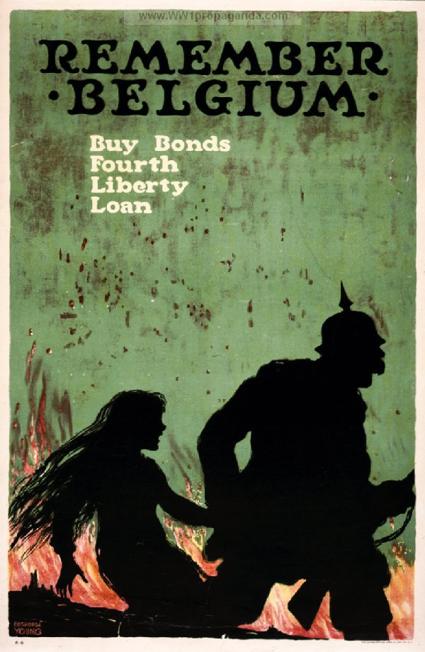
The Home Front: The Impact of Total War
Total War: the complete mobilization of a nation’s resources and people
War impacted lives of each member of society
Industrialized war: workers, supplies = troops
Governments took increased control
Conscription used to build massive armies
Freedom of speech restricted in times of war
Free markets gave way to planned economies
The manipulation of public opinion
Authoritarian regimes used force to fight unrest
Propaganda used to win over hearts & minds
Total war meant opportunities for women
Employed at jobs once thought beyond them
Paved way for post-war women’s suffrage mov’t

Slide 8
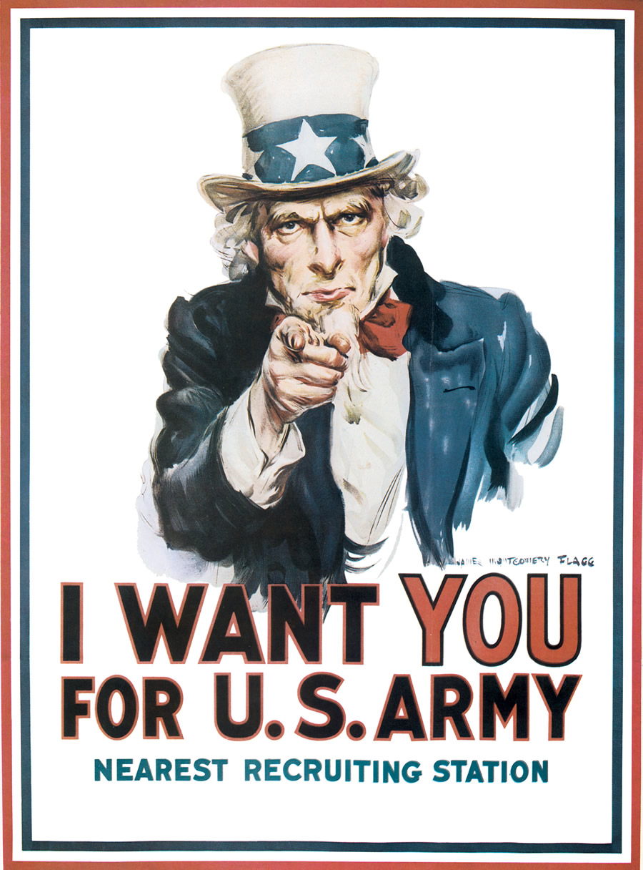
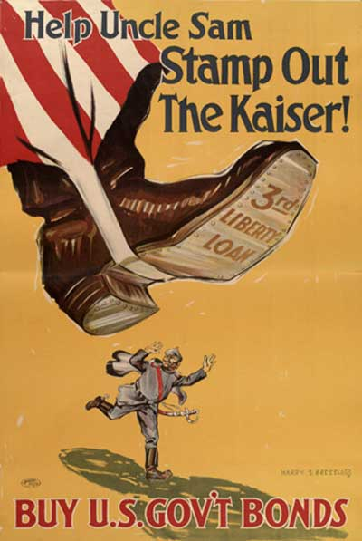

Slide 9
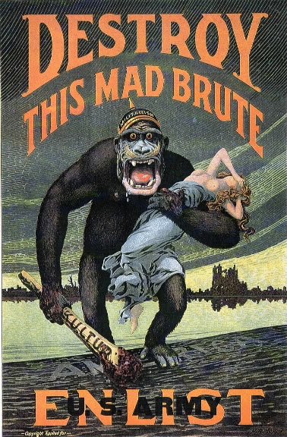
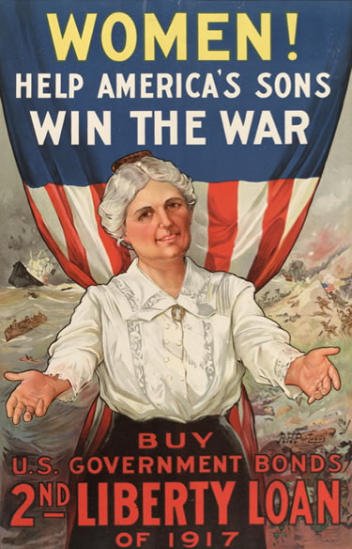

Slide 10
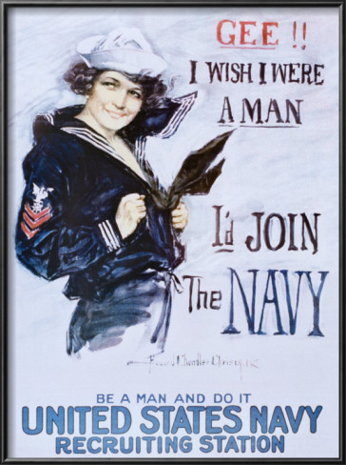

Slide 11
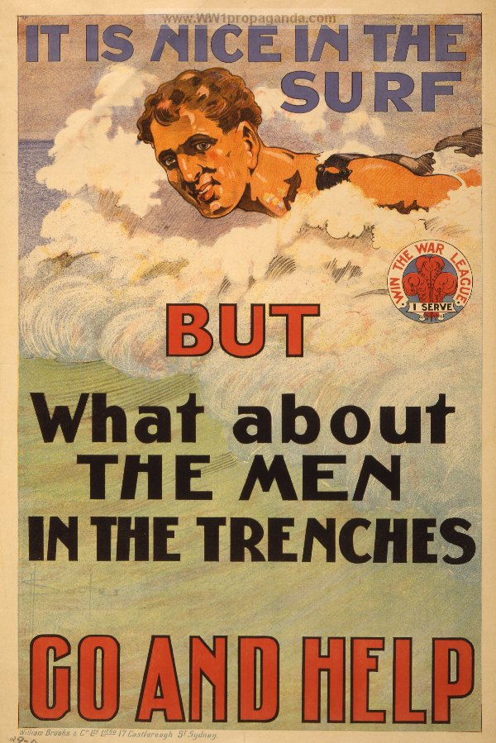
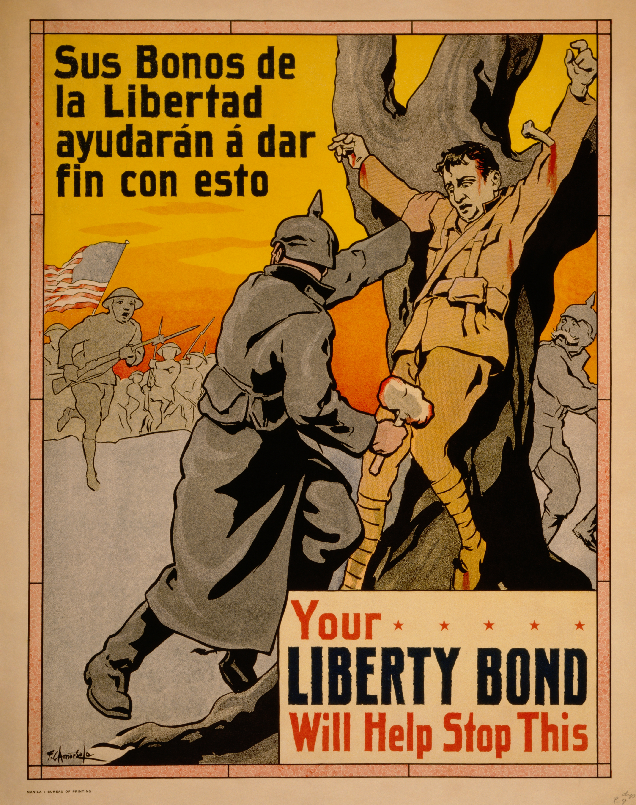

Slide 12
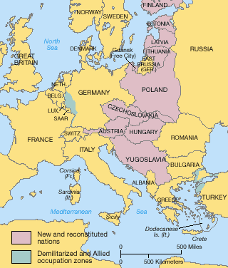
The Treaty of Versailles: A Lasting Peace?
Paris Peace Conference began Jan, 1919
Delegates of victorious nations (except Russia)
US Prez Wilson touted his Fourteen Points plan
Open diplomacy, arms reduction, self-determination
Britain and France entered meetings wanting revenge and to keep Germany weak
Germany signed Treaty of Versailles
Germans considered it a harsh peace settlement
Article 231 “War Guilt Clause”: Germany started it
Germans forced to pay reparations for damages
Limited size & location of German army & navy
Lost territory, including prized Alsace & Lorraine
Map of Eastern Europe redrawn by nationalism
Imposed democratic regimes in former kingdoms
League of Nations designed to prevent WWII
Nations could use diplomacy to settle disputes
The need for security on the Continent led France to support a buffer soon of new nations between Russia and Germany, carved out of the former Austrian Empire. German territory along the French border was demilitarized out of same concern for protection.

Slide 13
The First World War: 1914-1918 (Alliance Video)
Stalemate: The ________________ Front
After an initial advance by the central powers into France, both sides dug in miles outside Paris (First Battle of the Marne)
________ _________: fighting from ditches protected by machine gun and barbed wire (400+ miles long)
Life in trenches: horrible but not continual
“No Man’s Land”: between opposing trenches
Front did not move more than 10 mi. for 3 years
War of ___________________
____________ peaces out (figuratively—moves to the T.E.)
Transition from “gentleman’s war” to modern warfare
__________________ Truce of 1914
Not shelling the enemy’s latrines or breakfasts
Uniforms
Corlett, Peter. Man in the Mud. Australian War Memorial. Diorama. 1986.

Slide 14
The First World War cont’d
The War at Sea
UK naval blockade broken by GER ____________________
GER unrestricted submarine warfare led sinking of merchant & passenger ships without warning (_______________________and others)
The _____________________ Front: marked by mobility
Battle of ____________________(1914): Russia dominated by superior weaponry & leadership of Germans
Russia continued to suffer huge losses thru 1917

Slide 15
The First World War cont’d
__________________ Empire and Gallipoli Campaign: Allies defeated (short: http://www.history.com/topics/world-war-i/battle-of-gallipoli/videos/allies-launch-disastrous-attack-at-gallipoli?m=528e394da93ae&s=undefined&f=1&free=false)
Middle East: Lawrence of Arabia
British forces from India, Australia, and New Zealand participate; ____________________ falls in 1918
Japan and Australia pick off German ___________________ in Pacific

Slide 16
The First World War (cont.)
Modern Warfare: Rise of War Machines
Examples:
The Role of _________________________
Began the war as officially __________________, attempted to sell goods to both Germany & United Kingdom
US joined Allies due to German hostile acts
Fervor over sinking of US merchant ships, Lusitania
____________________ Note intercepted, US public outraged
Unrestricted submarine warfare ultimately drove US to war
US declared war on Germany in April, 1917 providing fresh supply of ___________, _______________, __________________
Marked steady advance of Allies toward Berlin
Germany surrender on November 11, 1918
Deaths: RUS 1.7mil, GER 1.6mil, FRA 1.3, UK 900k, A-H 800k, ITA 400k, Turkey 325k, USA 49k
Headstones of unknown Allied soldiers in Belgium

Slide 17
The Home Front: The Impact of Total War
_____________________: the complete mobilization of a nation’s resources and people
War impacted lives of each member of society
Industrialized war: workers, supplies = troops
Governments took increased control
____________________ used to build massive armies
Freedom of speech restricted in times of war
Free markets gave way to planned economies
The manipulation of public ____________________
Authoritarian regimes used force to fight unrest
Propaganda used to win over hearts & minds
Total war meant opportunities for __________________
Employed at jobs once thought beyond them
Paved way for post-war women’s suffrage mov’t

Slide 18
The Treaty of ____________: A Lasting Peace?
Paris Peace Conference began Jan, 1919
Delegates of victorious nations (except ______________)
US Prez Wilson touted his ______________ __________ plan
Open diplomacy, arms reduction, self-determination
Britain and France entered meetings wanting _______________ and to keep Germany weak
Germany signed Treaty of Versailles
Germans considered it a harsh peace settlement
Article 231 “________ _________ _____________”: Germany started it
Germans forced to pay reparations for damages
Limited size & location of German army & navy
Lost territory, including prized Alsace & Lorraine
Map of Eastern Europe redrawn by nationalism
Imposed democratic regimes in former kingdoms
________________________ designed to prevent WWII
Nations could use diplomacy to settle disputes
The need for security on the Continent led France to support a buffer soon of new nations between Russia and Germany, carved out of the former Austrian Empire. German territory along the French border was demilitarized out of same concern for protection.

